Slide 1
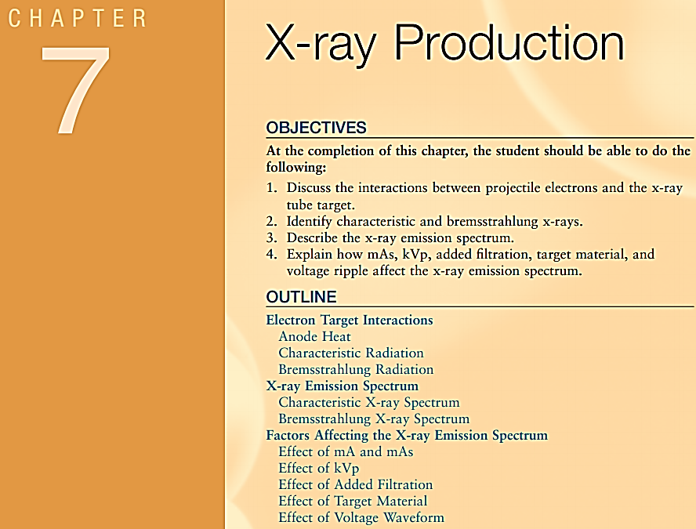

In The Name of God
X-Ray Production
Outline:
Electron target Interactions
x-ray productions
    two kinds of X-rays:
      1- Characteristic Radiation
      2- Bremsstrahlung Radiation
      X-ray emission spectrum
Factors Affecting X-Ray emission spectrum

Slide 2
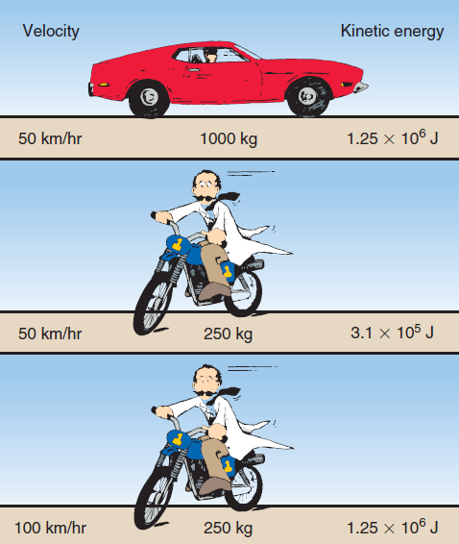
Electron Target Interactions
X-ray production: the interaction of the projectile electrons that are accelerated from the cathode to the X-Ray tube target.
Electron kinetic energy is increased by raising the kVp.
Kinetic energy is the energy of motion.
Stationary objects have no kinetic energy.
KE = 1/2mv²
Where
KE: is kinetic energy in joules.
m : the mass in kilograms,
v : velocity in meters per second,
Effect of kinetic energy on X-ray: As electron kinetic energy is increased,
both the intensity (quantity)
and the energy (quality) of the x-ray beam are increased

Slide 3
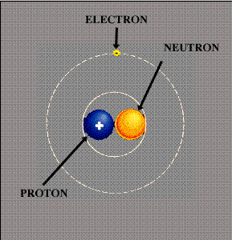
Atom – Element
Atom is a Greek word
An atom is the smallest particle that has
all the properties of an element
112 elements have been identified today
The fundamental Particles of an atom: are the Electron, Photon and the neutron
Nuclear Structure : Proton and Neutrons
The arrangement of the Electrons around the nucleus

Slide 4
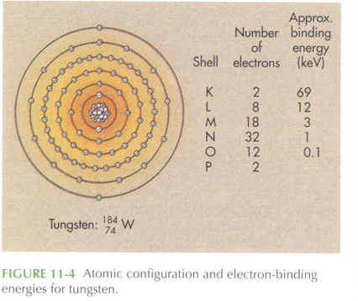
Atom Characteristics
Atomic Number: number of Proton ( Z)
Atomic Mass : number of Proton + number of Neutron ( A )
A = Z+N
₉₂²³⁸ U
Electron Orbits: The Possible electron orbits
  are grouped into different Shells.
  Electron Orbit Shells: given the code K, L, M, N and so forth
K:2 , L:8 , M:18 , N:32
Electron Binding Energy: The closer an electron to
the nucleus the bigger its binding energy.
K > L > M

Slide 5
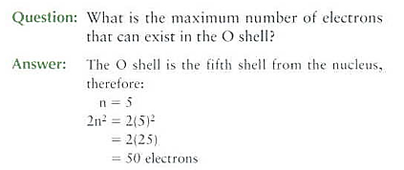
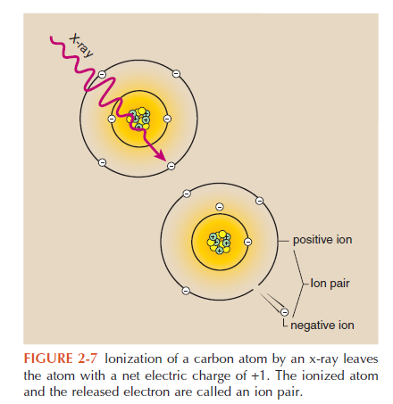
  The Maximum number of electron
  That can exist in each Shell 2n² (Square of two)
  n is the shell number
Atoms are electrically neutral
Total number of electrons in the orbit = the number of Protons
Ionization: is the removal of an electron from an atom

Slide 6
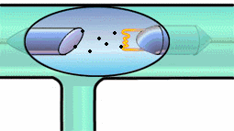
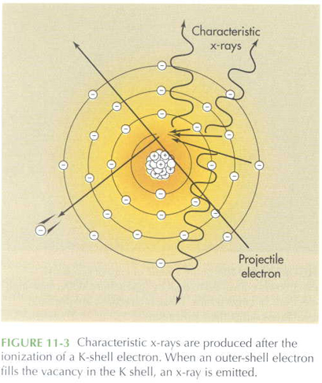
  Interaction of Electron and the Target
  Projectile electron (mA) : The electron travelling from
  cathode to anode (mA) = Projectile electron
  Kinetic Energy : Electron Kinetic Energy is because of the
  high voltage (kVp) between the cathode and the anode .
  Interaction of Electron and the Target
  When these Projectile electron hit the metal atoms of target they transfer their kinetic energy to the target atoms.
  The projectile electron interacts with either the
  A) orbital electron or
  B) the nuclear field of target atoms.
  These interaction results: Conversion of kinetic energy into
  heat (99% )and
  X-Ray (1%)
  Only approximately 1% of electron kinetic energy is
  used for the production of x-radiation

Slide 7
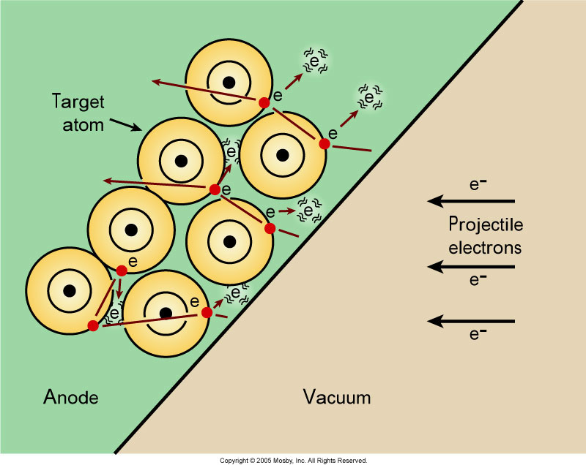
Heat
Conversion to heat : Most kinetic energy of projectile e- is converted into heat – 99%
X –Radiation: Only 1% of projectile e- kinetic energy is used for production of X –Radiation
The efficiency of X-ray production : is Independent of mA
Doubling the x-ray tube current doubles the heat produced
Projectile e- interact with the outer-shell e- of the target atoms but do not transfer enough energy to the outer-shell e- to ionize
Increasing kVp: The efficiency of X-ray production
increases with increasing kVp.
and will also increase heat production

Slide 8
X-Ray Production & Emission
Those interaction produces two types of X-Ray
1- Characteristic and
2- Bremsstrahlung
When electrons are accelerated from the cathode to the target of the anode, three effects take place:
1- the production of heat,
2- the formation of characteristic x-rays
3- the formation of bremsstrahlung x-rays.
Characteristic x-rays : are produced when an electron ionizes an inner-shell electron of a target atom. As the inner-shell void is filled, a characteristic x-ray is emitted.
Bremsstrahlung x-rays : are produced by the slowing down of an electron by the target atom’s nuclear field.

Slide 9
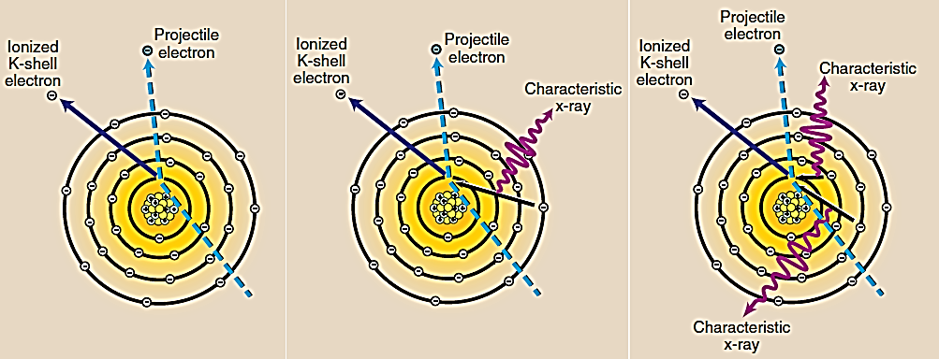
1- Characteristic Radiation
Production of the Characteristic Radiation : If the projectile electron interacts with an inner-shell electron of the target atom characteristic X-Rays can be produced
Characteristic x-rays are emitted when an outer-shell electron fills an inner-shell void.
Characteristic x-rays are produced after ionization of a K-shell electron.
When an outer shell electron fills the vacancy in the K shell, an x-ray is emitted.

Slide 10
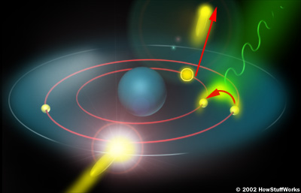
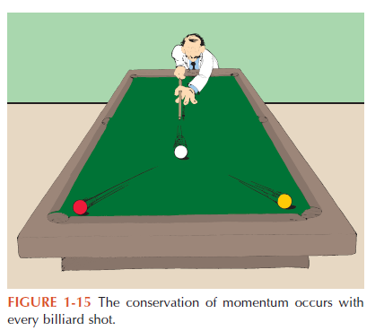
Characteristic Radiation cont..
Production of Characteristic x-rays :
The projectile electron with high enough energy
totally remove an inner-shell electron of the target
when outer-shell e- fills an inner-shell
Energy of Characteristic X-Ray : Since the electron binding
energy differs for every element, the energy of
characteristic X-Ray also differ.
Characteristic Name:
It is called characteristic because it is characteristic
of the target element in the energy of the photon produced

Slide 11
K-characteristic x-rays : when a K-shell electron is ionized, its position can be filled with electrons from any of the outer shells.
All of these x-rays are called K x-rays .
Useful Radiation: Only K-characteristic x-rays of tungsten are useful for imaging. Because of its efficiency energy
Percentage of Characteristic and Bremsstrahlung Radiation :
Approximately 15% of the x-ray beam is characteristic radiation and the remaining percentage is Bremsstrahlung (at 100 kVp)

Slide 12
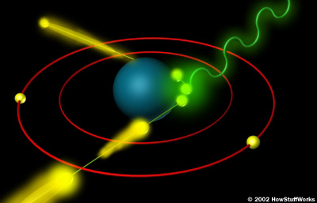
X-Ray Production
2- Bremsstrahlung Radiation
is a German word meaning slowed - down radiation
Bremsstrahlung : is produced by interacting of projectile e- with the nucleus of a target (tungsten atom)
Loosing Energy: A projectile electron can lose any amount of its kinetic energy in an interaction with a target
Converting Energy: A projectile e - pass close enough to the nucleus of the atom to convert some of its kinetic energy to EM energy.
Distance to nucleus : The closer the projectile electron gets to the nucleus,
more it is influenced by the electric field of the nucleus

Slide 13
Calculation of X-Ray Energy
In the diagnostic range most X-Rays are Bremsstrahlung Radiation
E _{ph} = h.f = h.C/λ
E _{max} = hC/λ
λ _{min} = hc/E _{max} = (4.15 *10 ⁻¹⁵ )*(3* 10 ⁸ ) / kVp
λ _{min} = 12.4/kVp (Å) = (10⁻ ¹⁰) Angstrom
f: frequency
C: velocity of light = 3* 10 ⁸
h: Plank's Constant = 4.15 *10 ⁻¹⁵
λ: Wave length of X-Ray
kVp : Tube voltage, voltage between cathode and anode

Slide 14
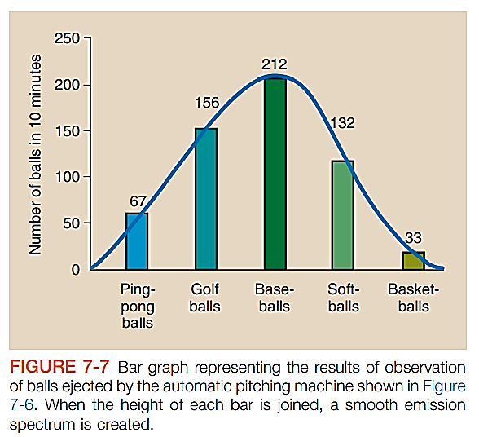
X- Ray Emission Spectrum
The word spectrum : refers to the range of types of values of any quantity such as x-rays.
This type of relationship is fundamental to describing the radiation output of an x-ray tube.
The relative number of x-rays emitted is plotted as a function of the energy of each individual x-ray.
X-ray energy is the variable that is considered.

Slide 15
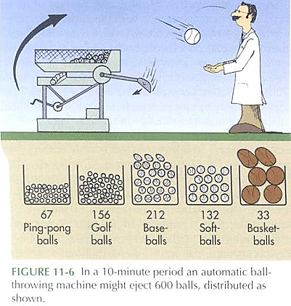
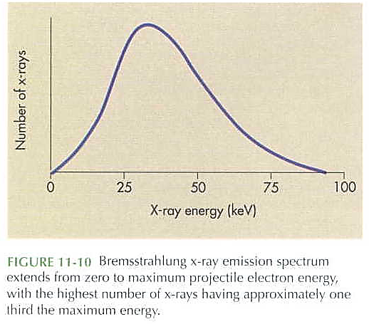
Bremsstrahlung X-ray Spectrum
Here, the relative number of x-rays emitted is plotted as a
function of the energy of each individual x-ray.
A continuous spectrum contains all possible Values
.Energy level of Bremsstrahlung x-rays:
it can have any energy level up to the set kVp value.
Brems x-rays can be produced at any projectile e- value
Brems x-rays have a range of energies and form a
continuous emission spectrum
The general shape of an emission spectrum is always the same,
but the position along the energy axis can change

Slide 16
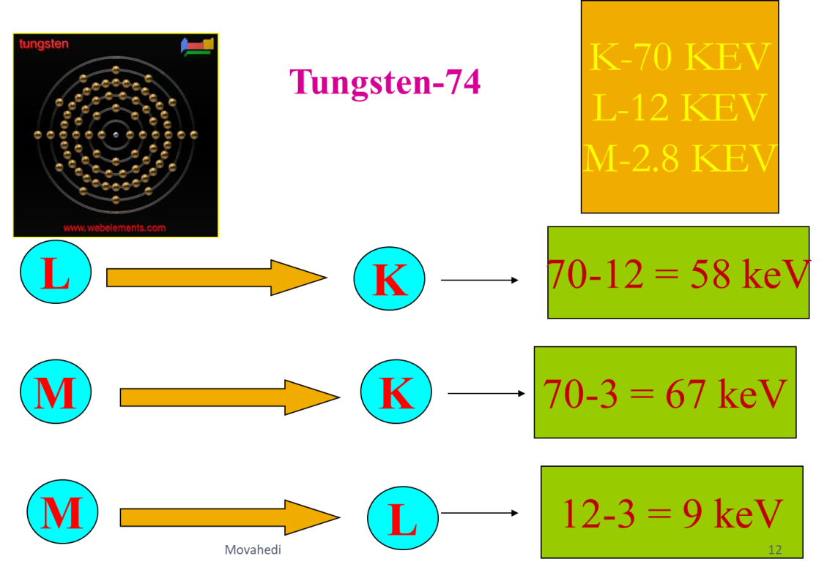
Production of Characteristic x-rays for Tungsten
The transition of an orbital electron from an outer shell to an inner shell is accompanied by the emission of an X-Ray.
The X-Ray has energy equal to the difference in the binding energies of the orbit electron involved.
The discrete energies of characteristic x-rays : are characteristic of the differences between electron binding energies in a particular element.
A characteristic x-ray from tungsten,
can have 1 of 15 different energies
(see Table ) and no others.

Slide 17
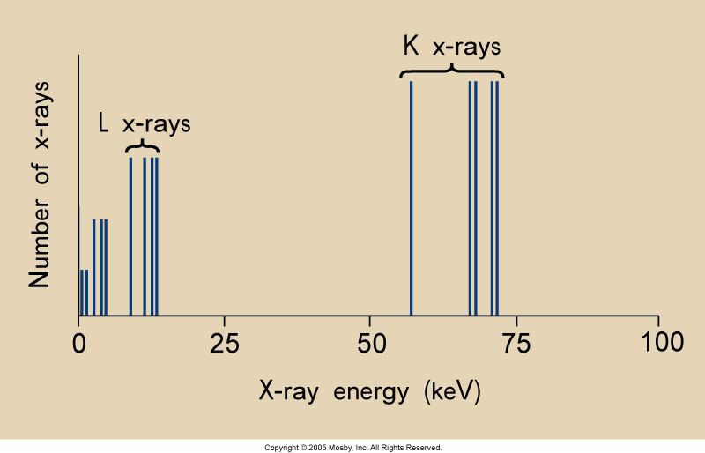
Characteristic X-Ray Spectrum
A plot of the frequency with which characteristic x-rays are emitted as a function of their energy
Such a plot is called the characteristic x-ray emission spectrum
Characteristic has discrete energies based on the e - binding energies of target (tungsten)
Tungsten Target
Characteristic x-rays have very specific energies.
K-characteristic x-rays require a tube potential of a least 70 kVp
(Tungsten as Target)
  Two spectrums : from L shell to K shell
  α₁ = 59.3 kev α₂ = 57.9 kev
  spectrums : from M shell to K shell
  β₁= 67.2 kev
  spectrums : from N to K
  β₂= 69 kev

Slide 18
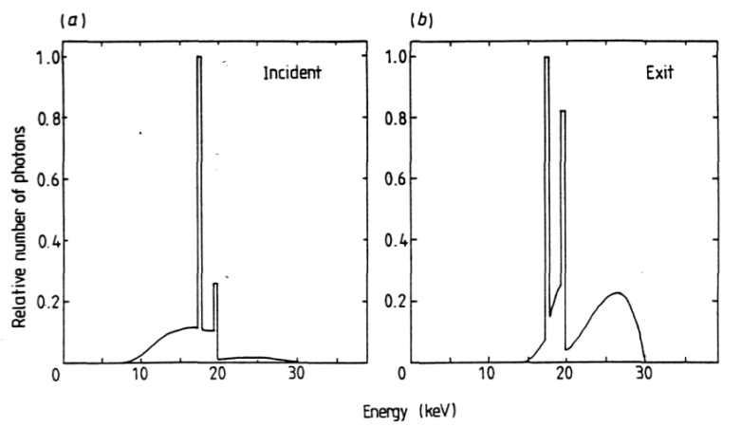
Factors Affecting the x-ray emission spectrum
A number of factors under the control of radiographers influence the size and shape of the x-ray emission spectrum and therefore the quality and quantity of the x-ray beam.
1- Tube current (mA) , Time (S) = mAs
2- Tube voltage (kVp)
3-- Added filtration,
4- Target material
5- Voltage waveform
6- Distance (d)
Bremsstrahlung and Characteristic X-ray Spectrum

Slide 19
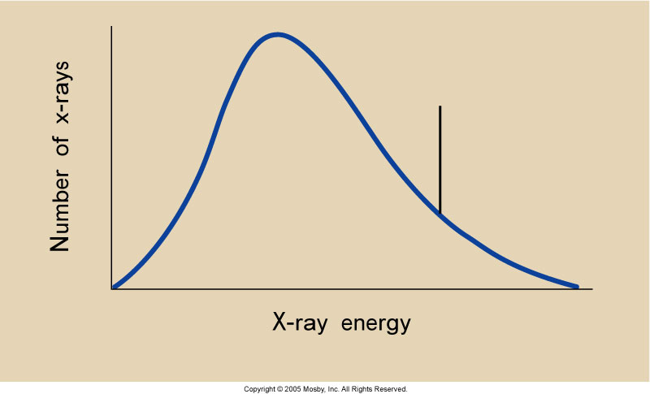
X-ray Quality or Penetrability
Energy of an x-ray : As the energy of an x-ray beam is increased, the penetrability is also increased
High-energy photons : are able to penetrate tissue farther than low-energy photons
High-quality = high-penetrability
The farther to the right the higher the effective energy or quality
X-ray Quantity : number of X-Ray
The more values in the curve (number of X-Ray), the higher the x-ray quantity
mAs: Mili ampere - seconds (mAs) – x-ray quantity is proportional to mAs

Slide 20
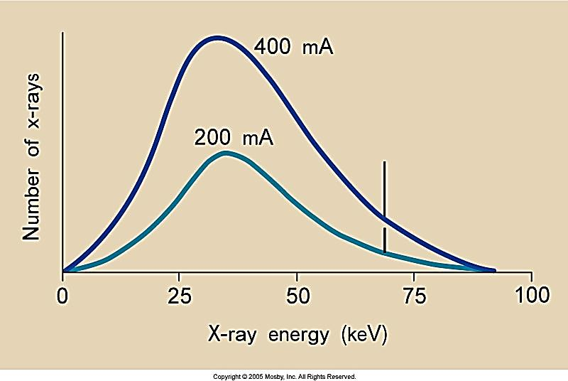
Factors Affecting the x-ray emission spectrum (conte ..)
1- Effect of mA and mAs
Tube current (mA) , Time (S) = mAs
A change in mA: results in a proportional change in number of X-ray
( the amplitude )
The shape of the curve: will remain the same
If mA were doubled: the X-ray number would be doubled too
figure: changes the current from 200 to 400 mA ,
twice as many electrons will flow from the
cathode to the anode.

Slide 21
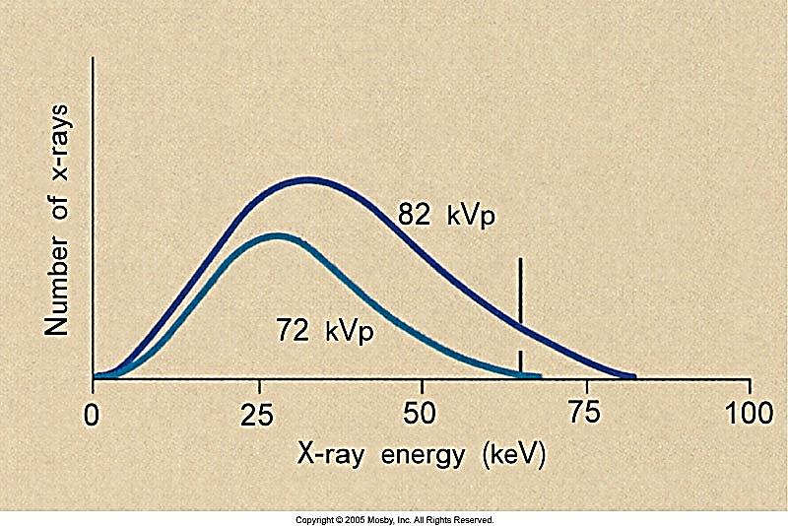
Factors Affecting the x-ray emission spectrum (conti ..)
2- kVp (Kilovolt Peak )
A change in kVp affects both the
A- production ( number of x- rays )and
B- X- Rays energy
Increasing Factor : If kVp increases the x-ray intensity would increase by a factor of kVp² (the square of the factor)
(amplitude and the position of the x-ray emission spectrum)
figure : The lower spectrum represents x-ray operation at 72 kVp, and the
upper spectrum represents operation at 82 kVp
Higher kVp : as kVp raised, the area under the curve increases.
approximating the square of the factor by which kVp was increased (kVp² )
Shifting the Curve : The curve has shifted to the right,
the more x – rays are emitted at all energies
kVp and discrete X-Ray : A change in kVp has no effect on the position of the discrete X-Ray emission spectrum

Slide 22
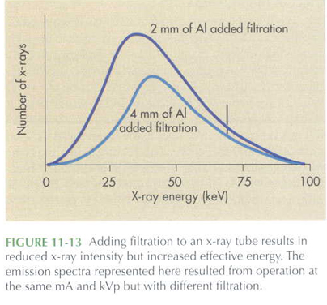
Factors Affecting the x-ray emission spectrum (conti ..)
3- Effect of Added Filtration
The aim of Filtration: reducing patient dose
1 to 3 mm of aluminum (Al) added to the primary beam to reduce the number of low-energy x-rays that reach the patient,
Adding filtration Effects
quantity of x-rays : reduces the quantity of x-rays in the
low-energy range
average energy : increases the average energy
(higher quality) with a reduction in x-ray quantity
(called hardening the x-ray beam )
Effective Energy : increasing the effective energy
Effect on Characteristic spectrum: is not affected & the maximum energy of x-ray emission is not affected
The shape of the curve: Lowering the amplitude and shifting to the right
Effect is shown in Figure: where an x-ray tube is operated at 95 kVp with 2-mm aluminum (Al) added filtration compared with 4-mm Al added filtration.

Slide 23
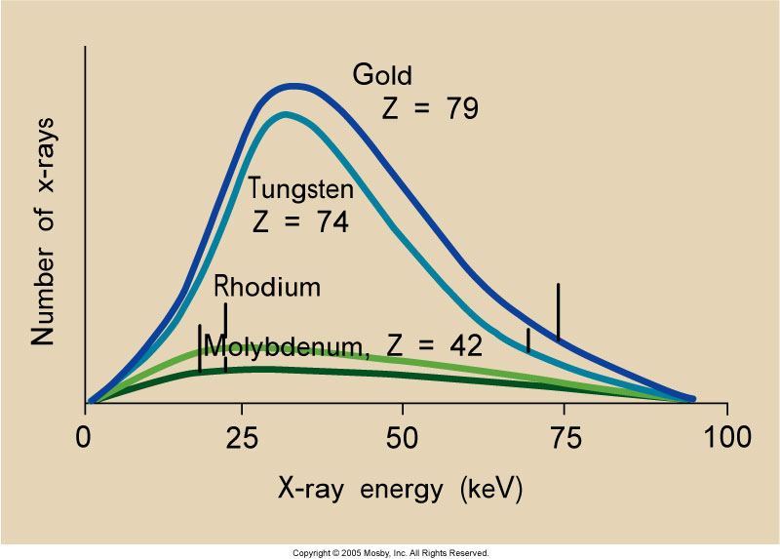
Factors Affecting the x-ray emission spectrum (conti ..)
4- Effect of Target Material
The atomic number of the target: affects both the quantity and quality
of x-rays
Increasing the target atomic number increases the efficiency of x-ray :
1-production ( number of x- rays )and
2- X- Rays energy (the energy of characteristic and bremsstrahlung )
Investigating the effect : with an increase in target atomic number.
1- Discrete emission spectrum : shifts to the right with an increase in the atomic number of the target material. Figure:
2- The continuous spectrum : increases slightly in
amplitude, particularly to the high-energy side.

Slide 24
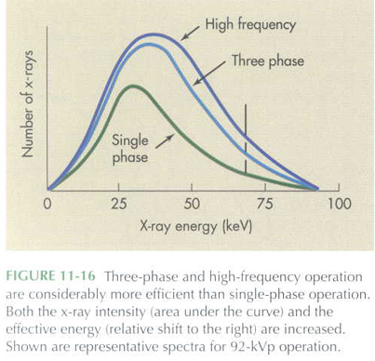
Factors Affecting the x-ray emission spectrum (conte ..)
5- Effect of Voltage Waveform
voltage waveforms:
There are principally five voltage waveforms
produced by x-rays generators
half-wave rectification,
full-wave rectification,
3-phase/6-pulse,
3-phase/12-pulse,
and high-frequency.
Three- Phase vs. Single-Phase Power:
operation with three-phase power or higher frequency:
increase in kVp : is equivalent to an approximate 12%
increase in mAs : Doubling of mAs over single-phace power
(Because of reduced ripple)
FIGURE 7-15 As the voltage across the x-ray tube increases from zero to its peak value, x-ray intensity and energy increase

Slide 25
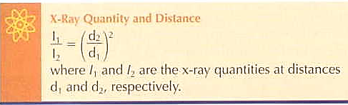
Factors Affecting the x-ray emission spectrum (conti ..)
6 - Effect of Distance
Distance of an x-ray : x-ray intensity varies inversely with the square of the distance from the x-ray target

Slide 26

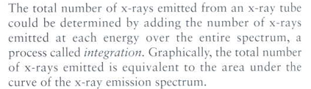
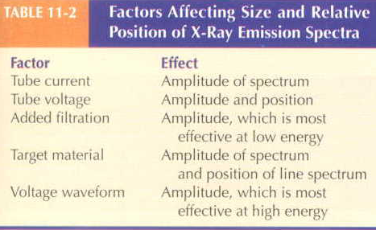

Slide 27

The End

Slide 28

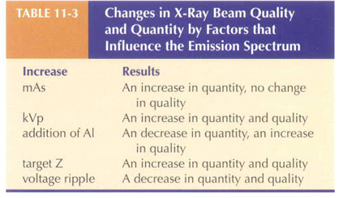
c

Slide 29


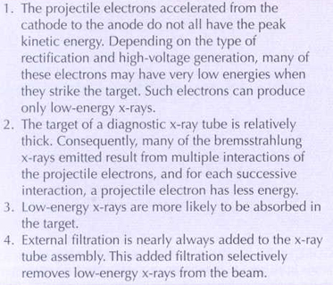
c

Slide 30

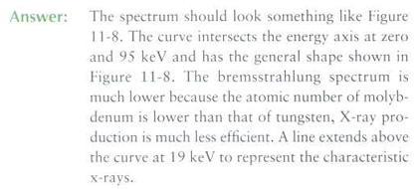

Slide 31

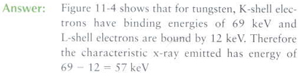
c

Slide 32

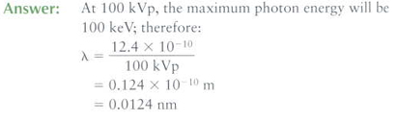
c

Slide 33
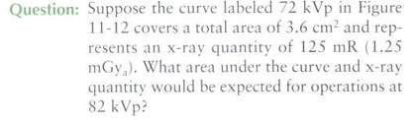
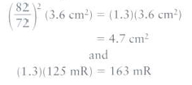

Slide 34
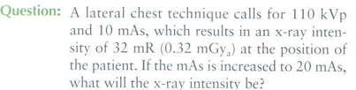




A

Slide 35
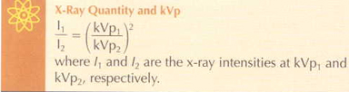
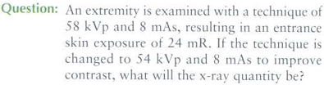
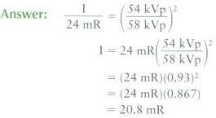
A

Slide 36
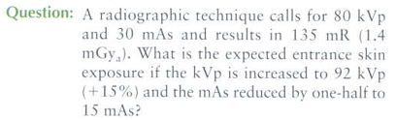
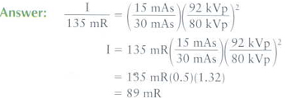
A

Slide 37
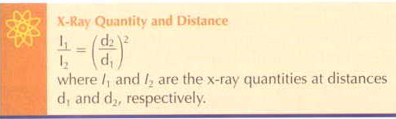
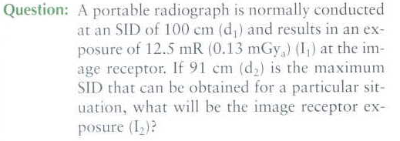
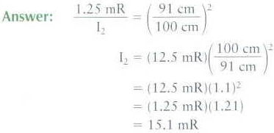
A

Slide 38


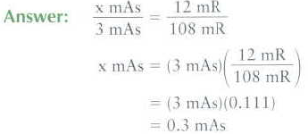
A

Slide 39

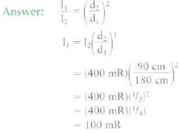
یک تیوپ اشعه ایکس تابشی با 70Kvp , 200 mAs انجام میدهد؛
که شدت آن 400میلی راد ( mR 400) یا 4 میلی گری در فاصله 90سانتی متری است
اگر فاصله به 180 سانتی متر افزایش یابد شدت چقدر خواهد شد.

Slide 40
یک تیوپ اشعه ایکس تابشی با 110Kvp , 10 mAs انجام میدهد؛
که شدت آن 32میلی راد ( 32mR) یا 0.32 میلی گری است اگر میلی آمپر به 20 mA افزایش یابد شدت چقدر خواهد شد.
A

Slide 41
c

