Slide 1
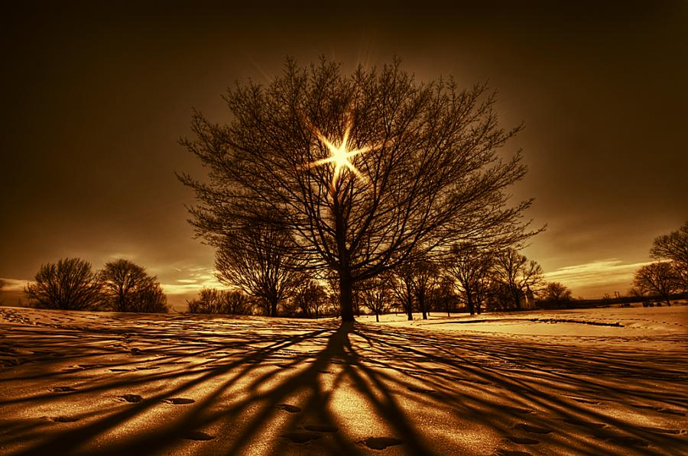
Introduction to
OPTIC
AR Mehdizadeh MD PhD
Department of medical physics,SUMS

Slide 2
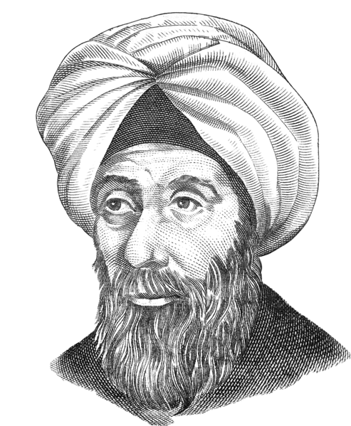
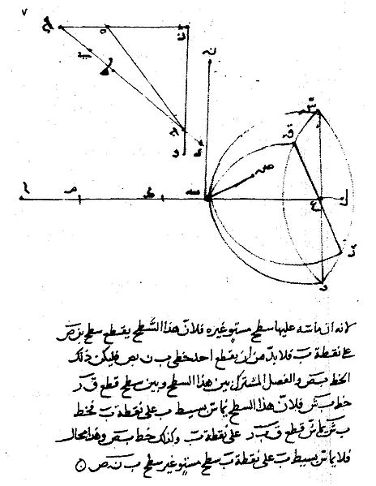
History
Ibn al-Haytham (Alhazen)
Notes:
Timeline of electromagnetism and classical optics
424 BC Aristophanes "lens" is a glass globe filled with water.(Seneca says that it can be used to read letters no matter how small or dim)^{[1]}
3rd century BC Euclid is the first to write about reflection and refraction and notes that light travels in straight lines^{[2]}
130 A.D. — Claudius Ptolemy (in his work Optics) wrote about the properties of light including: reflection, refraction, and color and tabulated angles of refraction for several media
1021 — Ibn al-Haytham (Alhazen) writes the Book of Optics, studying lens (optics)es, the psychology of vision, and the Camera obscura
1269 — Pierre de Maricourt describes magnetic poles and remarks on the nonexistence of isolated magnetic poles
1305 — Dietrich von Freiberg uses crystalline spheres and flasks filled with water to study the reflection and refraction in raindrops that leads to primary and secondary rainbows
1604 — Johannes Kepler describes how the eye focuses light
1604 — Johann Kepler specifies the laws of the rectilinear propagation of light
1611 — Marko Dominis discusses the rainbow in De Radiis Visus et Lucis
1611 — Johannes Kepler discovers total internal reflection, a small-angle refraction law, and thin lens optics,
1621 — Willebrord van Roijen Snell states his Snell's law of refraction
1630 — Cabaeus finds that there are two types of electric charges
1637 — René Descartes quantitatively derives the angles at which primary and secondary rainbows are seen with respect to the angle of the Sun's elevation
1657 — Pierre de Fermat introduces the principle of least time into optics
1665 — Francesco Maria Grimaldi highlights the phenomenon of diffraction
1673 — Ignace Pardies provides a wave explanation for refraction of light
1675 — Isaac Newton delivers his theory of light
1676 — Olaus Roemer measures the speed of light by observing Jupiter's moons
1678 — Christiaan Huygens states his principle of wavefront sources,
1704 — Isaac Newton publishes Opticks, a corpuscular theory of light and colour
1728 — James Bradley discovers the aberration of starlight and uses it to determine that the speed of light is about 283,000 km/s
1746 — Leonhard Euler develops the wave theory of light refraction and dispersion
1752 — Benjamin Franklin shows that lightning is electricity,
1767 — Joseph Priestley proposes an electrical inverse-square law
1785 — Charles Coulomb introduces the inverse-square law of electrostatics
1786 — Luigi Galvani discovers "animal electricity" and postulates that animal bodies are storehouses of electricity,
1800 — William Herschel discovers infrared radiation from the Sun
1801 — Johann Ritter discovers ultraviolet radiation from the Sun
1801 — Thomas Young demonstrates the wave nature of light and the principle of interference
1802 — Gian Domenico Romagnosi notes that a nearby voltaic pile deflects a magnetic needle. His account is largely overlooked.
1808 — Etienne-Louis Malus discovers polarization by reflection
1809 — Etienne-Louis Malus publishes the law of Malus which predicts the light intensity transmitted by two polarizing sheets
1811 — François Jean Dominique Arago discovers that some quartz crystals continuously rotate the electric vector of light
1816 — David Brewster discovers stress birefringence
1818 — Simeon Poisson predicts the Poisson-Arago bright spot at the center of the shadow of a circular opaque obstacle
1818 — François Jean Dominique Arago verifies the existence of the Poisson-Arago bright spot
1820 — Hans Christian Ørsted notices that a current in a wire can deflect a compass needle
1825 — Augustin Fresnel phenomenologically explains optical activity by introducing circular birefringence
1826 — Georg Simon Ohm states his Ohm's law of electrical resistance
1831 — Michael Faraday states his law of induction
1833 — Heinrich Lenz states that an induced current in a closed conducting loop will appear in such a direction that it opposes the change that produced it (Lenz's law)
1845 — Michael Faraday discovers that light propagation in a material can be influenced by external magnetic fields (Faraday effect)
1849 — Hippolyte Fizeau and Jean-Bernard Foucault measure the speed of light to be about 298,000 km/s
1852 — George Gabriel Stokes defines the Stokes parameters of polarization
1864 — James Clerk Maxwell publishes his papers on a dynamical theory of the electromagnetic field
1871 — Lord Rayleigh discusses the blue sky law and sunsets (Rayleigh scattering)
1873 — James Clerk Maxwell states that light is an electromagnetic phenomenon
1875 — John Kerr discovers the electrically induced birefringence of some liquids
1879 — Jožef Stefan discovers the Stefan-Boltzmann radiation law of a black body and uses it to calculate the first sensible value of the temperature of the Sun's surface to be 5700 K
1888 — Heinrich Rudolf Hertz discovers radio waves
1895 — Wilhelm Conrad Röntgen discovers X-rays
1896 — Arnold Sommerfeld solves the half-plane diffraction problem
1905 — Albert Einstein demonstrates that Maxwell's Equations are not required to describe electromagnetic radiation if Special Relativity is taken into account
1919 — Albert Michelson makes the first interferometric measurements of stellar diameters at Mount Wilson Observatory (see history of astronomical interferometry)
1946 — Martin Ryle and Vonberg build the first two-element astronomical radio interferometer (see history of astronomical interferometry)
1953 — Charles H. Townes, James P. Gordon, and Herbert J. Zeiger produce the first maser
1956 — R. Hanbury-Brown and R.Q. Twiss complete the correlation interferometer
1960 — Theodore Maiman produces the first working laser
1999 — M. Henny and others demonstrate the Fermionic Hanbury Brown and Twiss Experiment

Slide 3
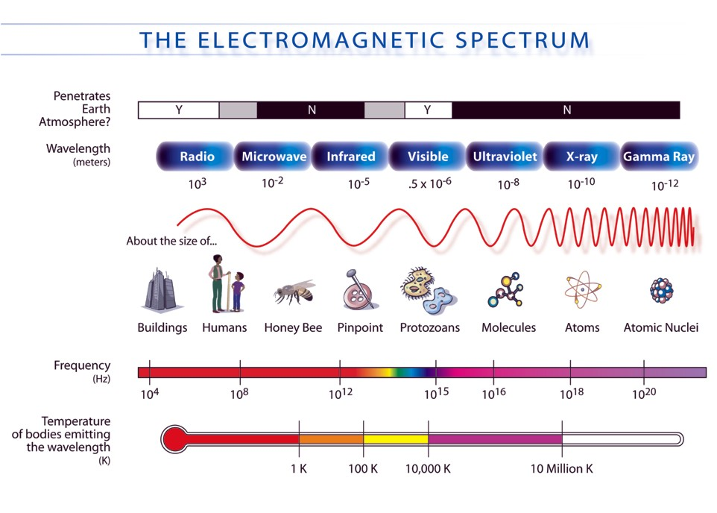

Slide 4
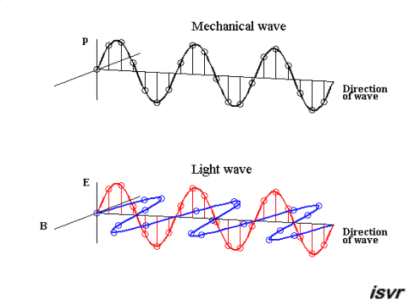
EM wave

Slide 5
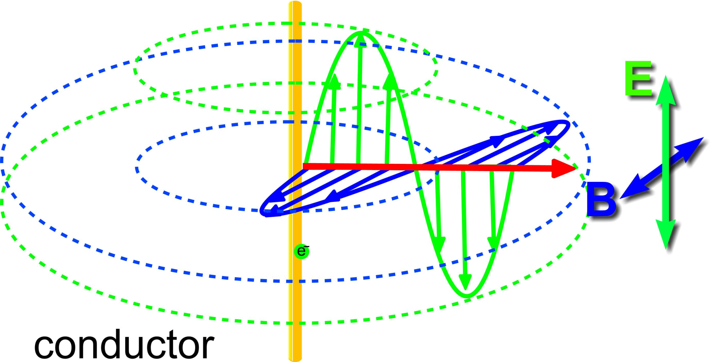
Polirization

Slide 6
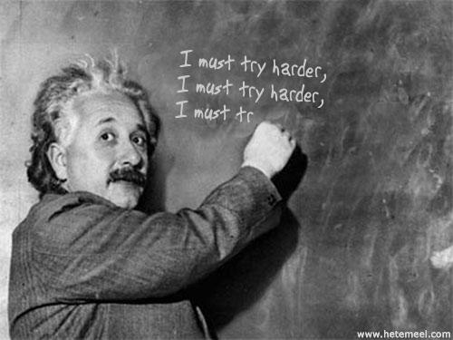
  Particle or Wave?
  Its depend on wave length
Speed of light c=λν (c=3X10⁸)
Particle
  Photo electric
  Campton effect
Wave
  Reflection
  Refraction
  Interference
  Diffraction
Notes:
Wave–particle duality
The modern theory that explains the nature of light includes the notion of wave–particle duality, described by Albert Einstein in the early 1900s, based on his study of the photoelectric effect and Planck's results. Einstein asserted that the energy of a photon is proportional to its frequency. More generally, the theory states that everything has both a particle nature and a wave nature, and various experiments can be done to bring out one or the other. The particle nature is more easily discerned if an object has a large mass, and it was not until a bold proposition by Louis de Broglie in 1924 that the scientific community realized that electrons also exhibited wave–particle duality. The wave nature of electrons was experimentally demonstrated by Davission and Germer in 1927. Einstein received the Nobel Prize in 1921 for his work with the wave–particle duality on photons (especially explaining the photoelectric effect thereby), and de Broglie followed in 1929 for his extension to other particles.

Slide 7
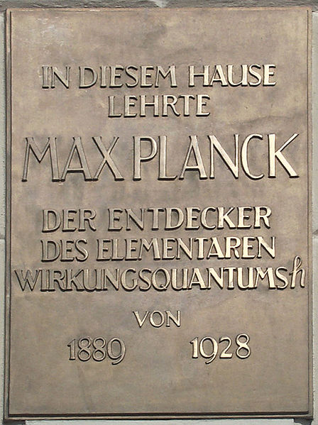
Particle Energy of light
Particle
E=hν (h=6.62X10^34 js)
E=hc/λ
E(ev)=12400/ λ(⁰A)
1 ev=1.6X10^19 j
1 ⁰A=10^-10 m

Slide 8
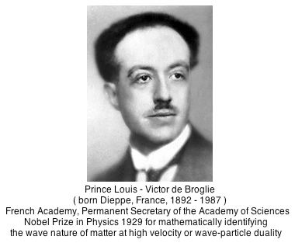
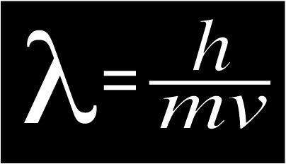
de Broglie's Wavelength
Energy of light wave
Wave
μ permeability constant

Slide 9
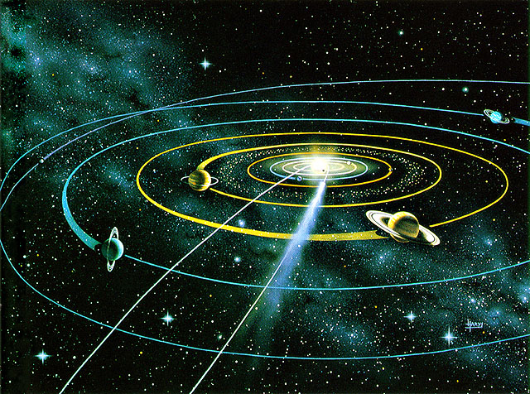
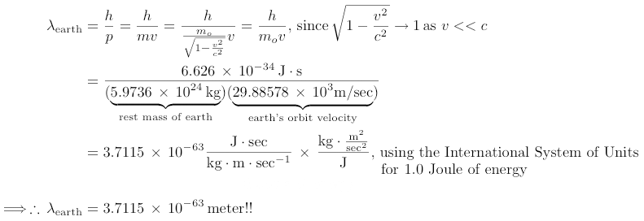
Find the de Broglie wavelength of earth whose rest or proper mass is 5.9736X10^24 kg and has orbit velocity of 29.88578X10^3 m/s?

Slide 10
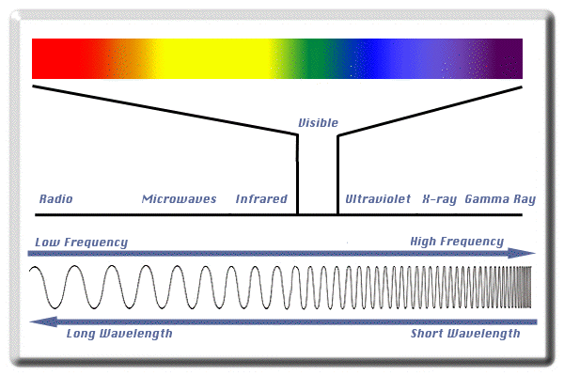
Visible light

Slide 11
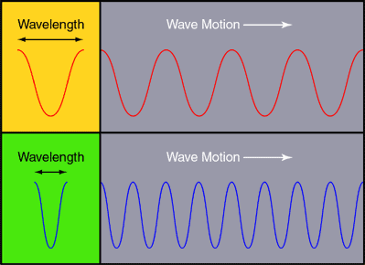
Calculate the photon energy range for visible light?
12400/4000=3.1 ev
12400/7500=1.6 ev
Photon energy range for visible light is [1.6-3.1]ev
λRed = 4000 A
λblue = 7500 A

Slide 12
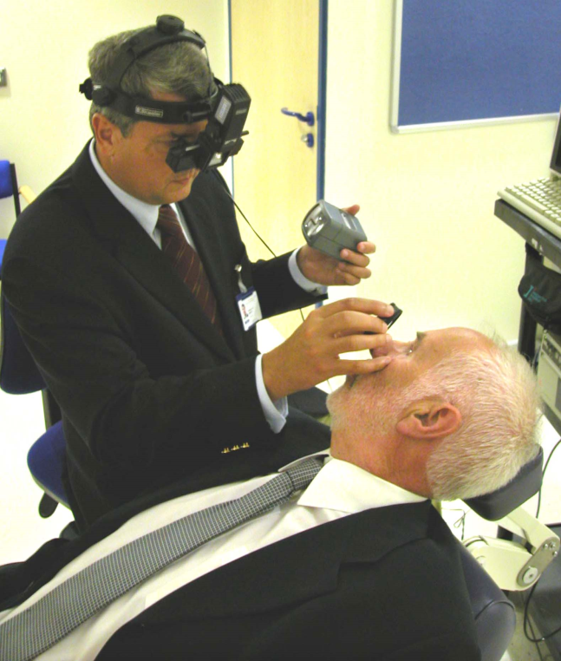
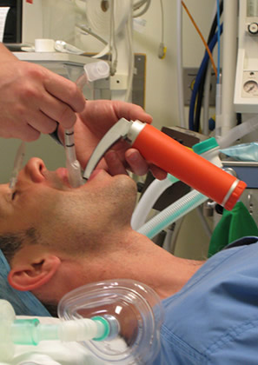
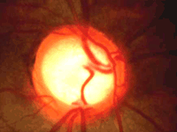
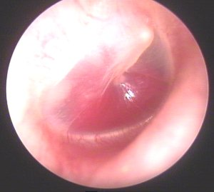
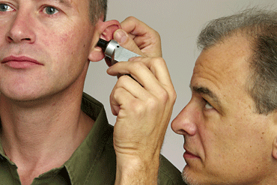
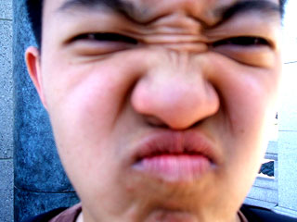
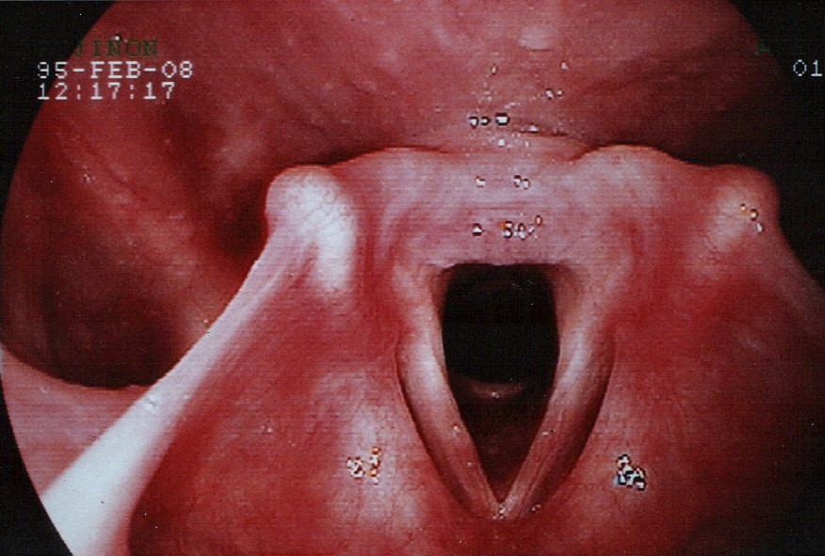
Light in medicine
Ophthalmoscope
otoscope
Laryngoscope
Nasoscope

Slide 13
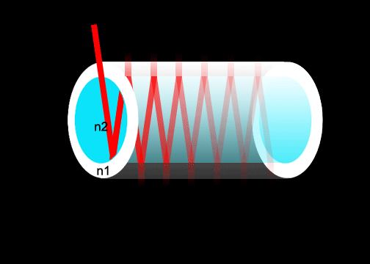
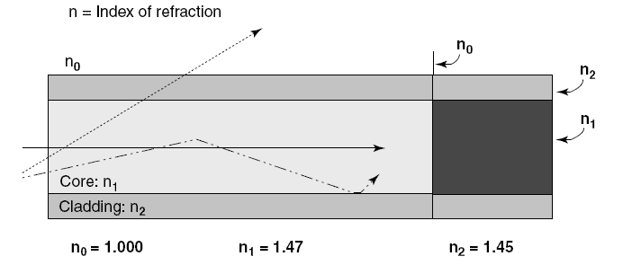
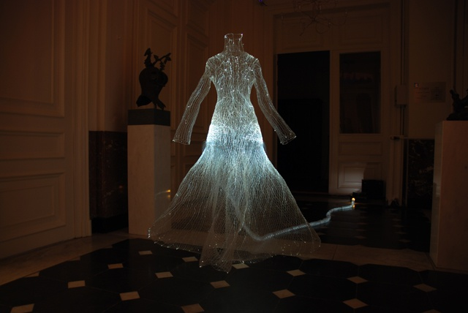
Fiber optics
Core refractive index>cladding refractive index

Slide 14
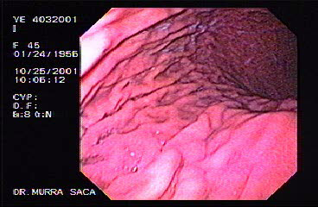
Endoscopy
Endoscope
Bronchoscope
Proctoscope
Cystoscope
…….
Notes:
Approximate Laparoscopy clinical volume (15 Years):‎
Laparoscopic Ileocystoplasty With Malone Procedure
First report in the world, (AUA 2003, Chicago)‎ ‎9
‎Laparoscopic Radical Prostatectomy New Sutureless Technique‎ ‎140
‎Laparoscopic Lich Gregoir Antireflux Technique ‎ 40
‎Totally Laparoscopic Uretero Cystoplasty ‎ ‎ 2‎
‎Laparoscopic Retroperitoneal and pelvic lymphadenectomy ‎ 20
‎Laparoscopic Pyeloplasty ‎ ‎250
‎Laparoscopic Donor Nephrectomy 900
‎Laparoscopic ‎ Simple Nephrectomy ‎ 250
‎Laparoscopic Radical Nephrectomy ‎ 150
‎Laparoscopic ‎ Adrenalectomy 130
‎Laparoscopic ‎ Repair of Retrocaval Ureter 6
‎Laparoscopic ‎ Uretero and Pyelolithotomy ‎ ‎180
‎Laparoscopic ‎ Nephrepexy ‎ ‎3
‎Laparoscopic Varicocelectomy ‎ 550
‎Laparoscopic Hernia and Hydrocele Repair ‎ ‎28‎
‎Laparoscopic Renal Cyst Decortication ‎ 60‎
‎Laparoscopiy For UDT and Orchiopexy ‎ 500‎
‎Laparoscopic ‎ Simple Prostatectomy ‎ ‎8
Laparoscopic Patial Nephrectomy 70
Laparoscopic Heminephrectomy 15
Laparoscopic Ureteroneocystostomy 15
Laparoscopic Nephrolithotomy 20
Laparoscopic Antireflux ( Gilvernet) 50
Total number over 3000 in 15 years

Slide 15
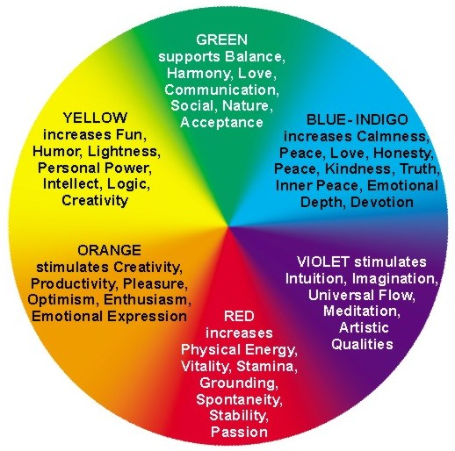
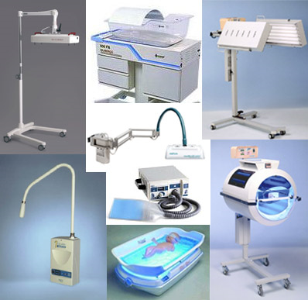
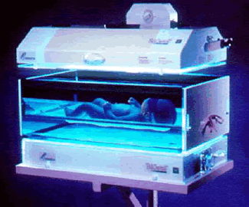
Light as a treatment modality
Photo therapy for Neonatal jaundice with λ=4050A
Color therapy

Slide 16
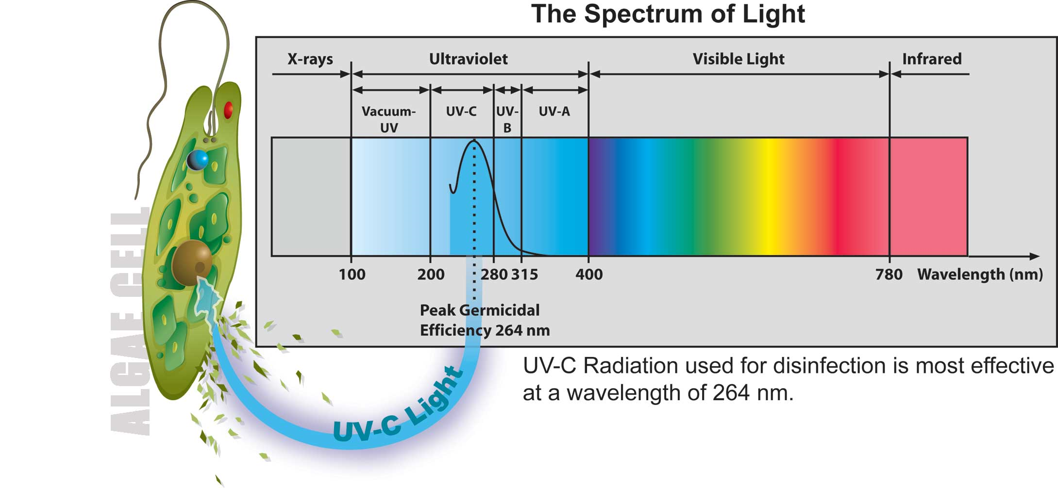
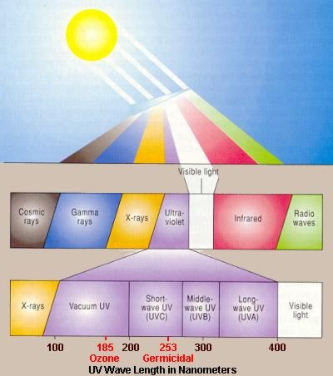
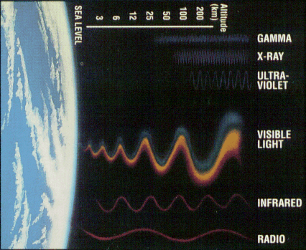
UV and its utilities

Slide 17
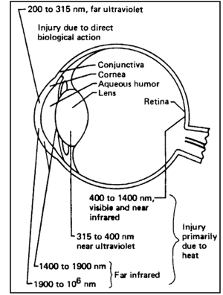

Slide 18
Radiation protection

Slide 19
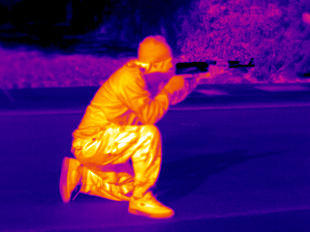
IR
Wien law λ= b/T(2.910^-3 mK)
Human surface body temperature is 34’C calculate the most common type of radiation from it?
λ= b/T(2.910^-3 mK)
10000 A in IR spectrum

Slide 20
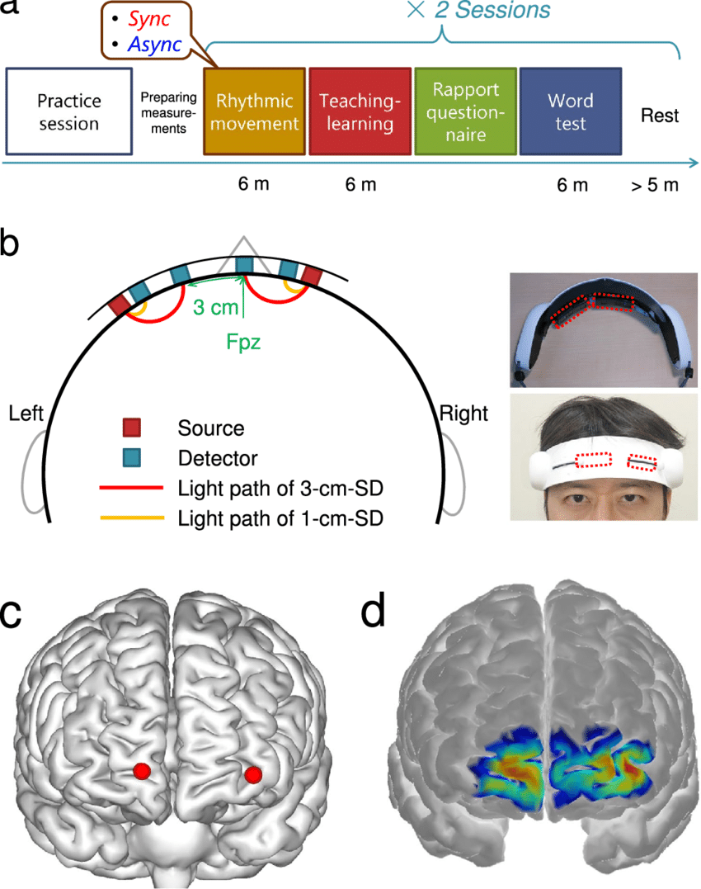
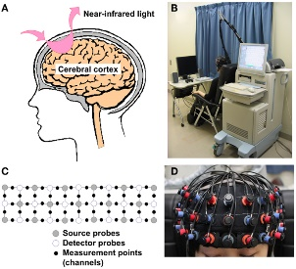
fNIRS

Slide 21
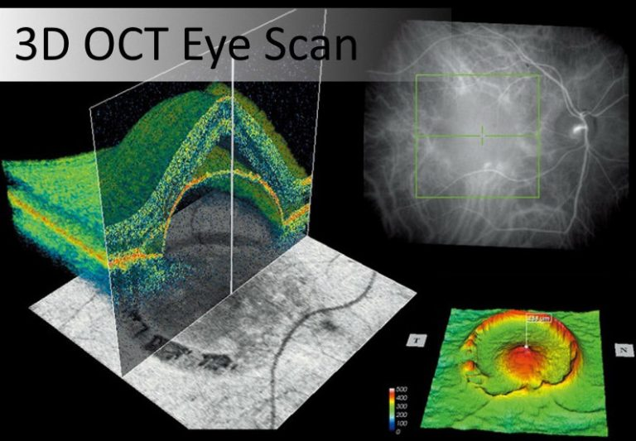
OCT

Slide 22
