Slide 1
The facilitated diffusion of charged solutes
1- Concentration
2- Solute charge and valance
3- Membrane potential

Slide 2
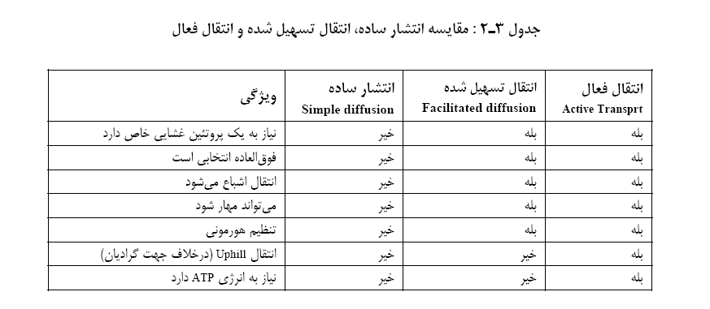

Slide 3


Slide 4
OSMOSIS

Slide 5
Definition
Is the flow of water across a semipermeable membrane from a compartment with lower concentration solute (higher chemical potential of water) to one with higher concentration of solute (lower chemical potential of water)

Slide 6
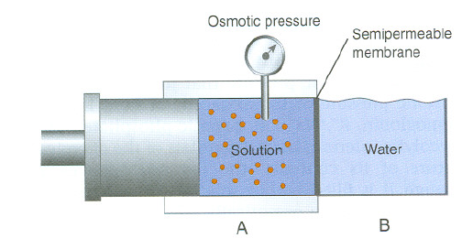
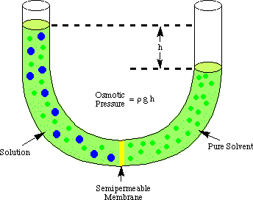
1M Glu= 0.5M NaCl= 0.333M CaCl2

Slide 7
6.02*10²³=MW=1mol
For NaCl= 6.02*10²³= 58.5=1mol=2 osmol
For Glu= 6.02*10²³= 180= 1mol=1osmol

Slide 8
For this reason, the concentration of osmotically active particles is usually expressed in osmoles.
An osmole is a unit of measurement that describes the number of moles of a compound
1m Glu= 1OSM Glu
1m NaCl=2OSM NaCl
1m Ca Cl2= 3OSM

Slide 9
Osmotic pressure depends on the number rather than the type of particles in a solution; that is, it is a fundamental colligative property of solutions.

Slide 10
Osmotic pressure depends on the number rather than the type of particles in a solution
1M Glu= 0.5M NaCl= 0.333M CaCl2

Slide 11
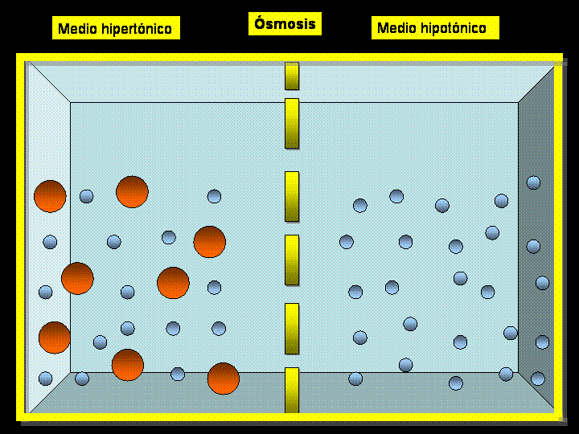
How could osm of a solute produce osmotic pressure?

Slide 12

2- Osmolar Concentration
Osmolarity is defined as the number of osmoles of solute per liter (L) of solution.
Osmolality is defined as the number of osmoles of solute per kilogram of solvent.

Slide 13
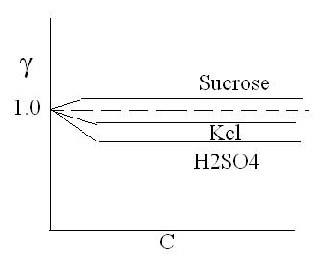


Osmotic Pressure
1- Van’t Hoff’s Law
(valid for ideal solution)
R= 0.082 Lit.atm.mole-1.deg-1
i= ion number after dissolving
M= concentration/ molality
Φ = osmotic coefficient

Slide 14
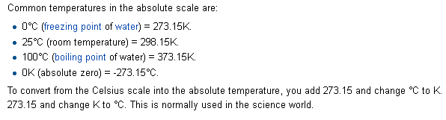

Slide 15
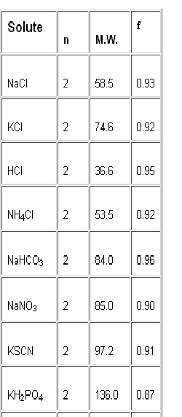

Slide 16
Iso osmolar
Hypo osmolar
Hyper osmolar

Slide 17
To exert osmotic pressure across a membrane, a molecule must not cross the membrane.

Slide 18
Tonocity
A) The steady state volume of the cell is determined only by the concentration of impermeant solute in the ECF

Slide 19
Effective osmotic pressure
Depend on both :
1- Concentration of solute particles
2- extend to which solute crosses membrane

Slide 20
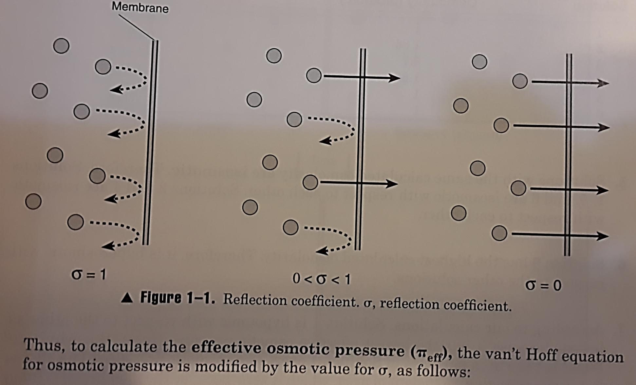

Slide 21

where σ is the reflection coefficient or osmotic coefficient and is a measure of the relative ability of the molecule to cross the cell membrane.

Slide 22
Isotonic : have same effective Osmotic pressure
Hypotonic: Lower effective Osmotic pressure
Hypertonic: Higher effective Osmotic pressure

Slide 23
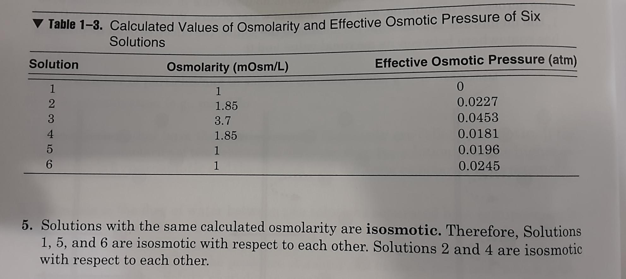

Slide 24
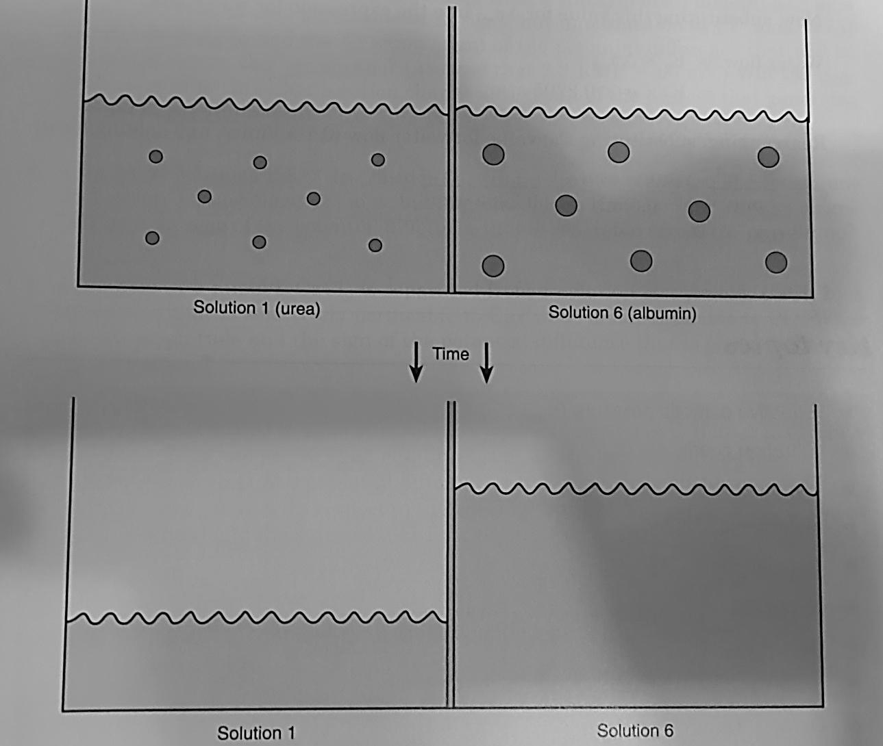

Slide 25
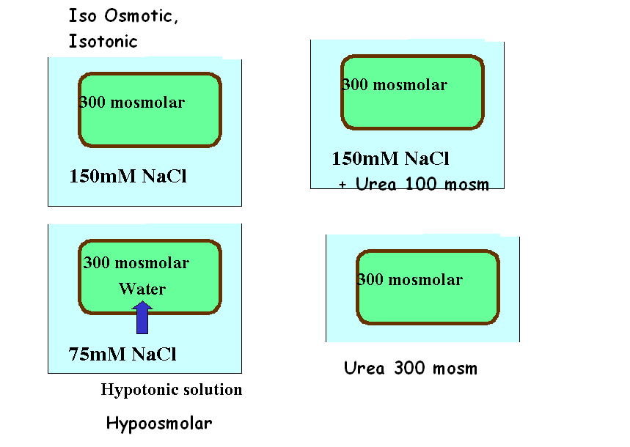
Tonicity
The tonicity of a solution is related to the effect of the solution on the volume of a cell.
Solutions that do not change the volume of a cell are said to be isotonic.
A hypotonic solution causes a cell to swell, whereas a hypertonic solution causes a cell to shrink.
150

Slide 26
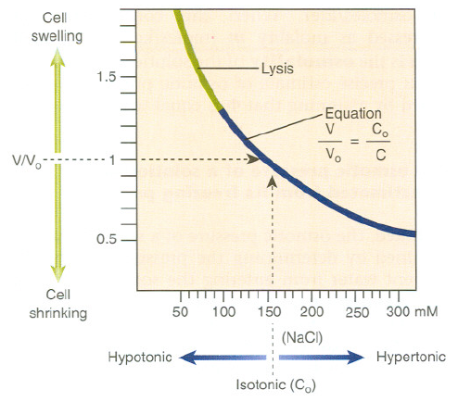
Cells swell or shrink in response to changes in the solute content of extracellular fluid

Slide 27
0.155 M NaCl (290 mOsm) + 0.05 M Glycerol ?

Slide 28
Isosmotic, Hyperosmotic, and Hypo-osmotic Fluids.

Slide 29
Consider two solutions: a 290-mmol/L solution of sucrose and a 290-mmol/L solution of urea.
Both solutions have an osmolality of 290 mOsm/kg H₂O and are therefore said to be isosmotic (i.e., they have the same osmolality).
When red blood cells are placed in the two solutions, those in the sucrose solution maintain their normal volume,
whereas those placed in urea swell and eventually burst. Thus, the sucrose solution is isotonic and the urea solution is hypotonic.

Slide 30
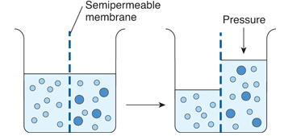
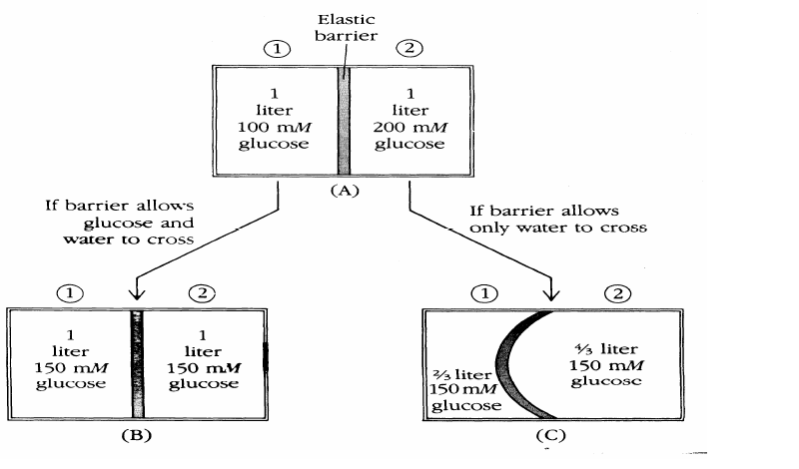

Slide 31
Example 1: Addition of Isotonic NaCl to ECF
Addition of an isotonic NaCl solution (e.g., intravenous infusion of 0.9% NaCl, osmolality of ≈290 mOsm/kg H₂O)
increases the volume of this compartment by the volume of fluid administered.
Because this fluid has the same osmolality as ECF and therefore also ICF, there will be no driving force for movement of fluid between these compartments, and the volume of ICF will be unchanged.

Slide 32
Example 2: Addition of Hypotonic NaCl to ECF
Addition of a hypotonic NaCl solution to ECF (e.g., intravenous infusion of 0.45% NaCl, osmolality of ≈145 mOsm/kg H₂O)
decreases the osmolality of this fluid compartment and results in movement of water into the ICF.
After osmotic equilibration, the osmolality of ICF and ECF is equal but lower than before the infusion, and the volume of each compartment is increased.

Slide 33
Example 3: Addition of Hypertonic NaCl to ECF
Addition of a hypertonic NaCl solution to ECF (e.g., intravenous infusion of 3% NaCl, osmolality of ≈1000 mOsm/kg H₂O)
increases the osmolality of this compartment and results in the movement of water out of cells.
After osmotic equilibration, the osmolality of ECF and ICF will be equal but higher than before the infusion.
The volume of ECF is increased, whereas that of ICF is decreased.

