Slide 1
بسم الله الرحمن الرحيم

Slide 2

Growth
Hormonal balance
*Accelerate : *Retardation
- Growth hormone - Cortisone
-Thyroxin - Hydrocortisone
-Testosterone - Estradiol
Two types:
-Appositional growth
- Interstitical growth

Slide 3
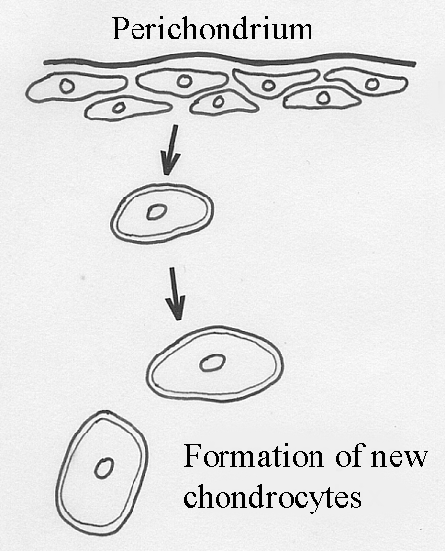
Appositional group

Slide 4
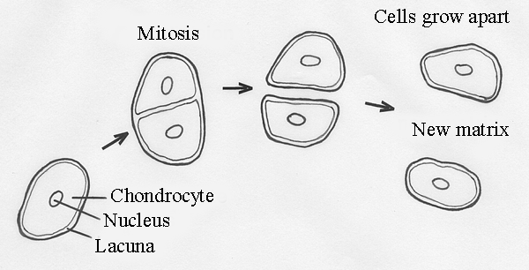
Interstitial group

Slide 5

Interstitical growth

Slide 6
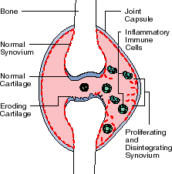
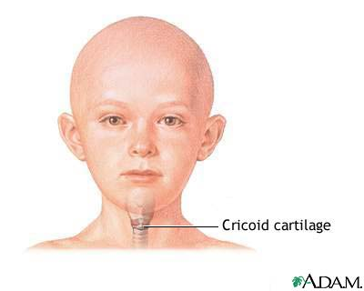
Degenerative changes
*Calcification of matrix
*Death of cells : - size of cell
- volume of cell
*Abnormal collagen fiber
Asbestiform degeneration
Hyaline cartilage

Slide 7
Regeneration
*Difficult
*Incompletely
*Scar dense connective tissue
*Young children

