Slide 1


بسم الله الرحمن الرحيم

Slide 2
Cartilage
Function
Structure
Growth
Types

Slide 3
Function
Support
Resistance (Mechanical Stress)
& Shock absorbing
Facilitating bone movement

Slide 4
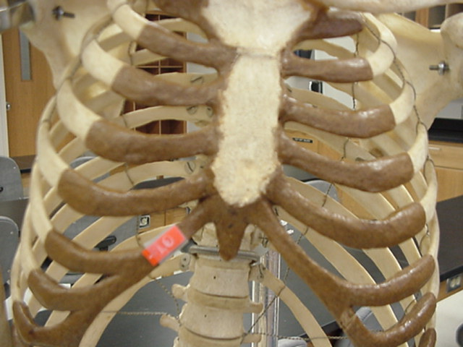
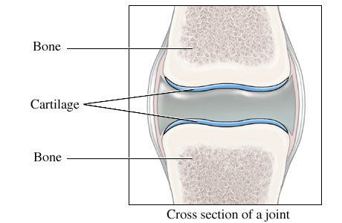
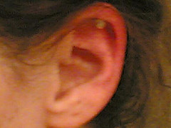
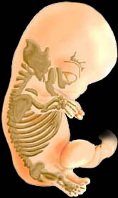
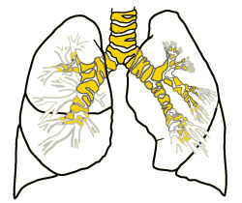

Slide 5
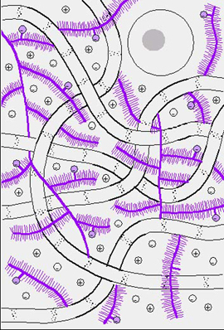
Structure
Ground substance
Cell
Fiber

Slide 6
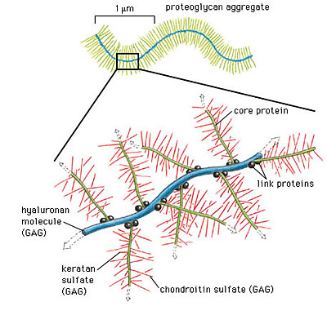
Ground Substance
Glycoprotein : chondronectin
Proteoglycan :
- protein
- glycosaminoglycan
( Sulfation) & (Hydration(

Slide 7
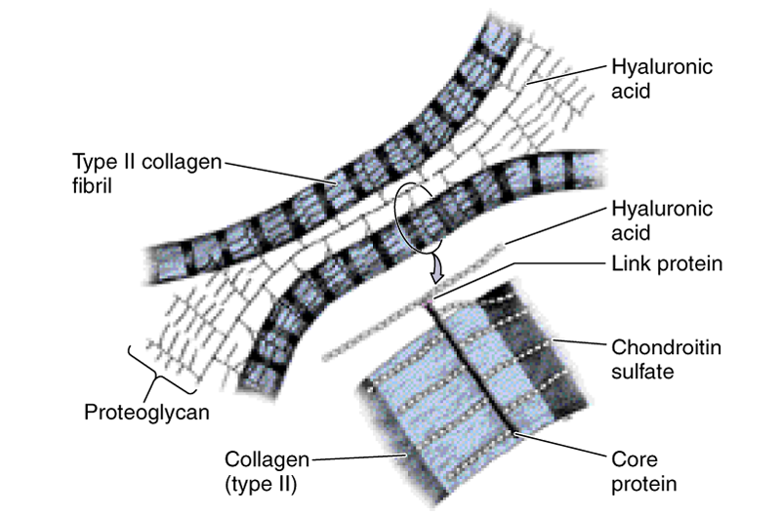
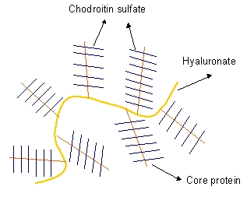
Hyaloronic acid+ prteoglycan
interact collagen
Proteoglycan agregate
proteoglycan + H2O shock absorbing

Slide 8
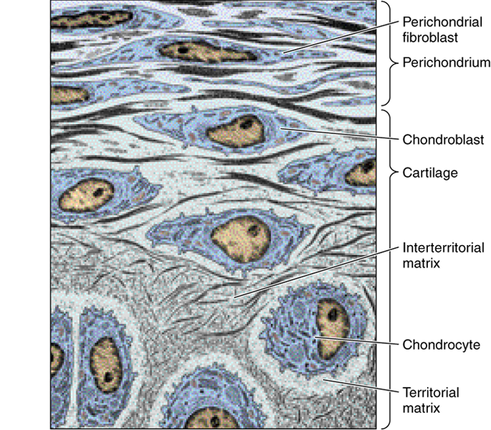
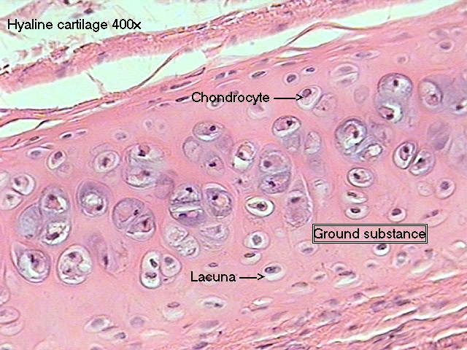
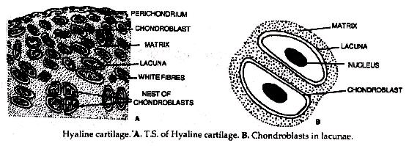
Cell
chondroblast
chondrocyte ( lacunae)
Isogenous group

Slide 9
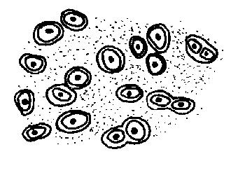
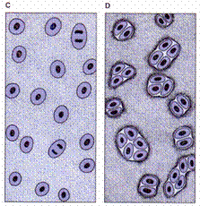

Slide 10
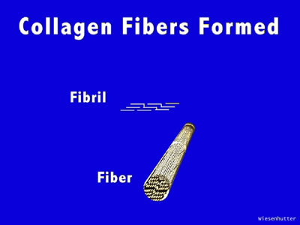
Fiber
Collagen type I
Collagen type II
Elastic

Slide 11
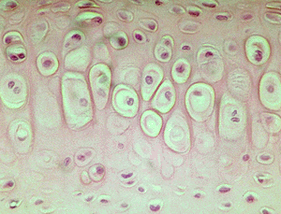
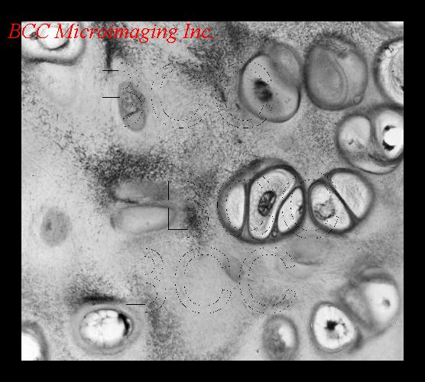
Matrix
-Territorial (Capsular) matrix
glycoseaminoglycan (PAS+)
Collagen
- Interterritorial matrix

