Slide 1
بسم الله الرحمن الرحيم

Slide 2
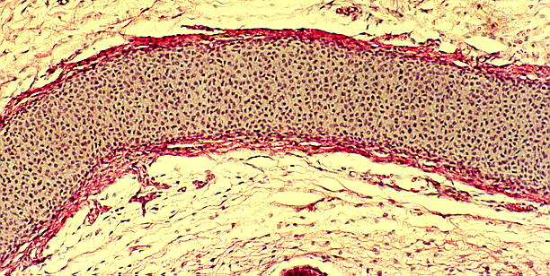
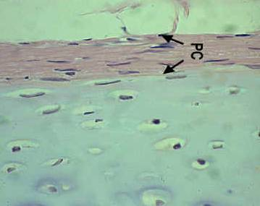

Perichndrium
Fibrous connective t.
Mesenchymal cell

Slide 3
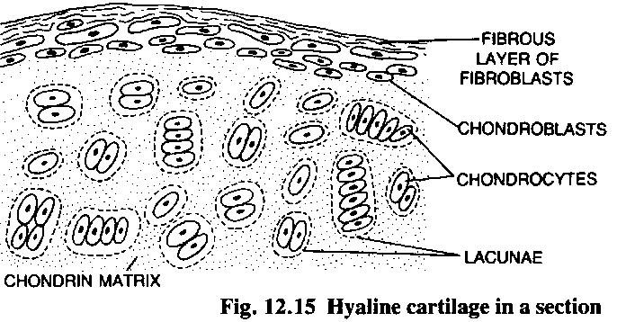
perichondrium

Slide 4
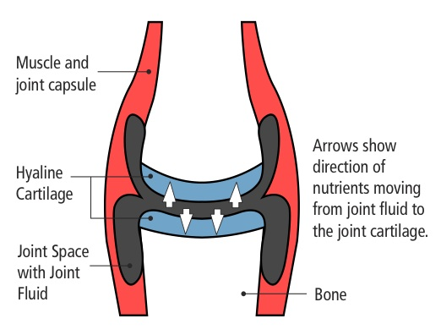
Aurticular cartilage
Has not perichondrium

Slide 5
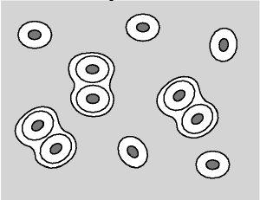
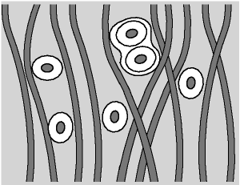
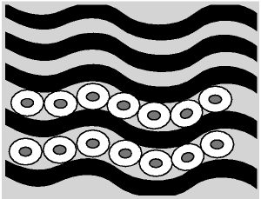
Type of cartilage
Hyaline cartilage
Elastic cartilage
Fibrous cartilage

Slide 6
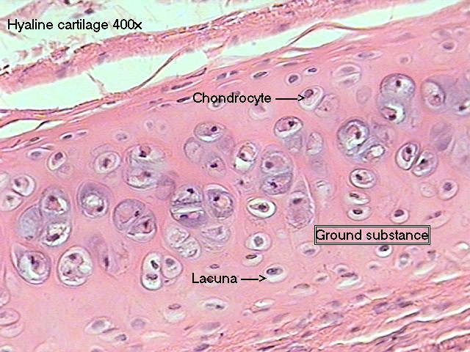
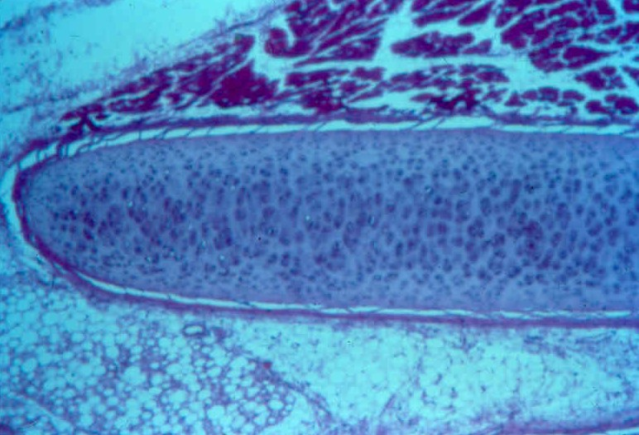
Hyaline cartilage
Bluish – White & Translucent
Collagen type II = Fibril

Slide 7
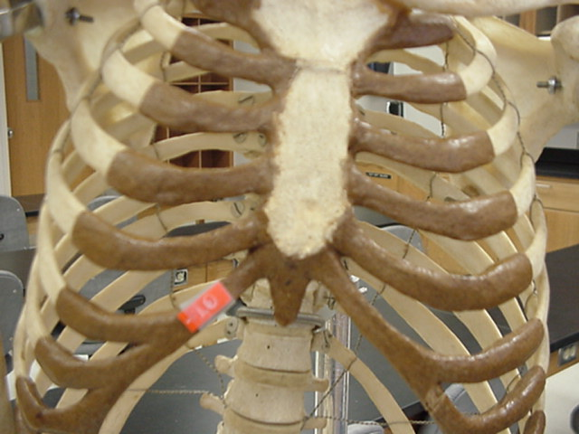
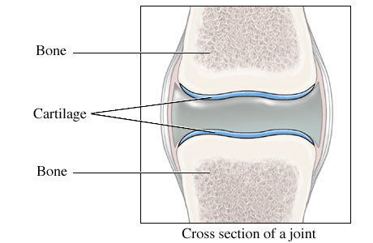
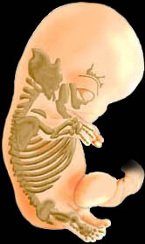
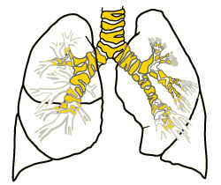
location

Slide 8
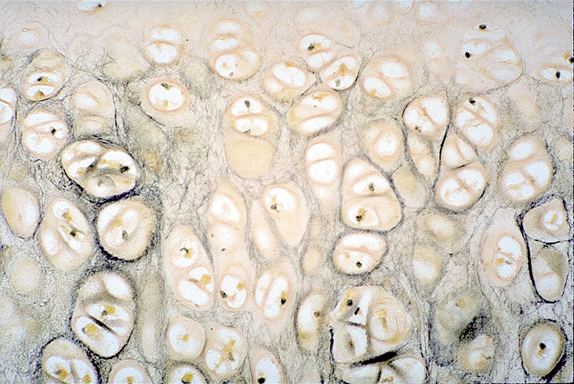
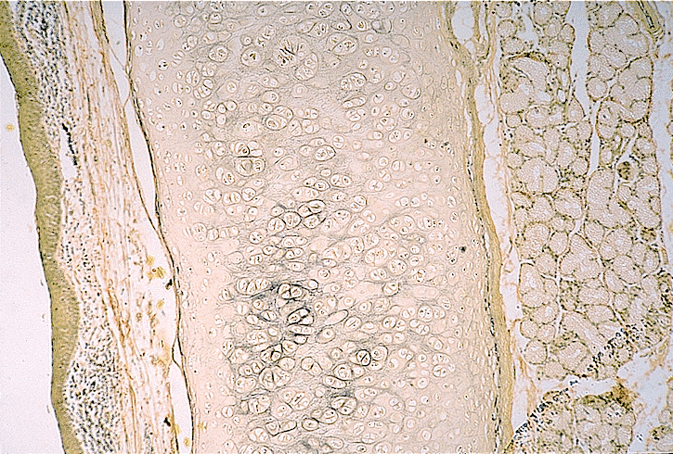
Elastic cartilage
Perichondrium
Isogenous groups
Collagen type II + Elastic fiber

Slide 9
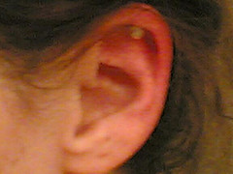


Slide 10
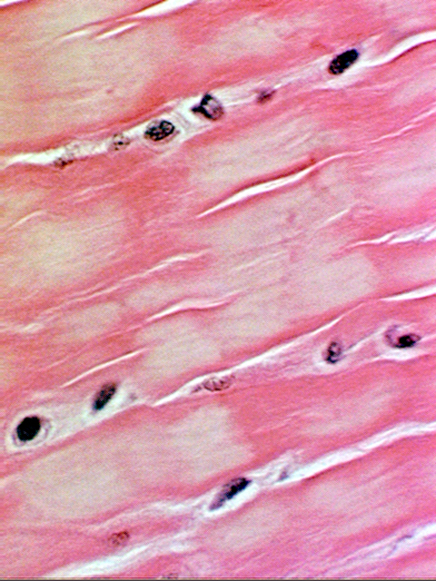
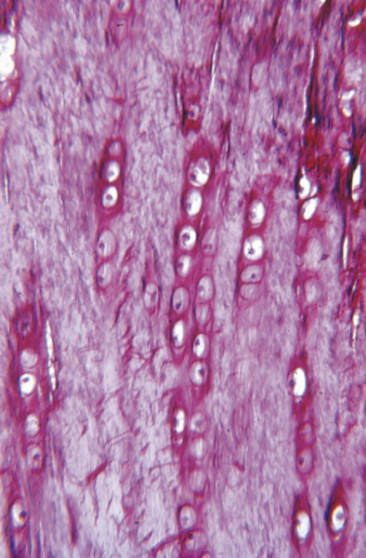
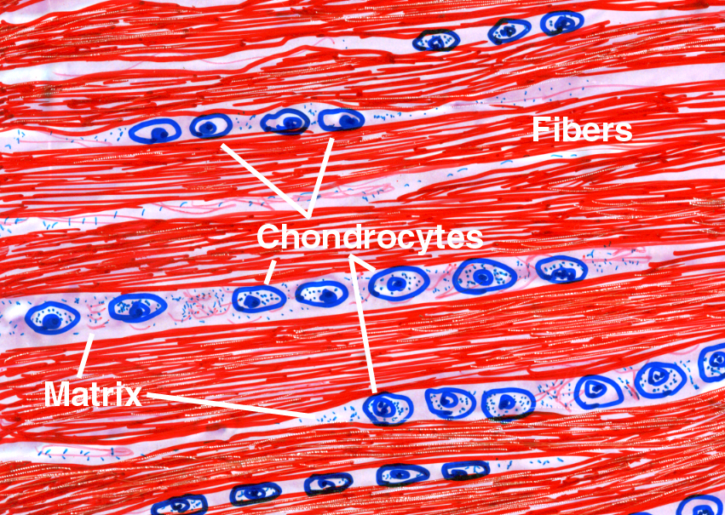
Fibrous cartilage
- Collagen type I : - Regular
- Irregular
- Chondrobalst long row
- Isogenous group
-Perichodrium No identifiable

Slide 11
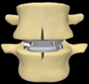
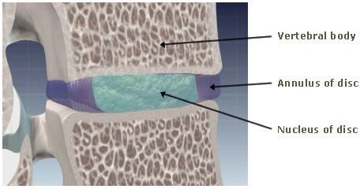
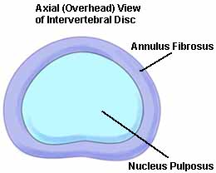
Type of fibrous cartilage
- Symphysis pubis
- Invertebral disk
1 ) Nucleous Pulposus
2 ) Annulus Fibrosus

Slide 12
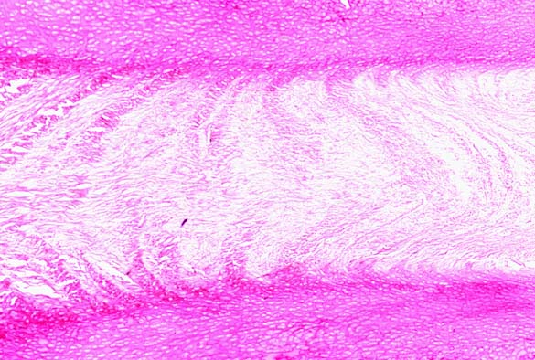
Invertebral disk
1 ) Nucleous Pulposus
- Hyaloronic acid
- Collagen type II
2 ) Annulus Fibrosus
- Fibrosus cartilage
- Collagen Type I

Slide 13
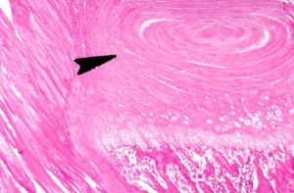
u
1 ) Nucleous Pulposus
2 ) Annulus Fibrosus

Slide 14


Slide 15
Thank you

