Slide 1

بسم الله الرحمن الرحيم

Slide 2
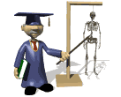

Skeletal system bone
Function
Structure
Type
Ossification
Joint

Slide 3
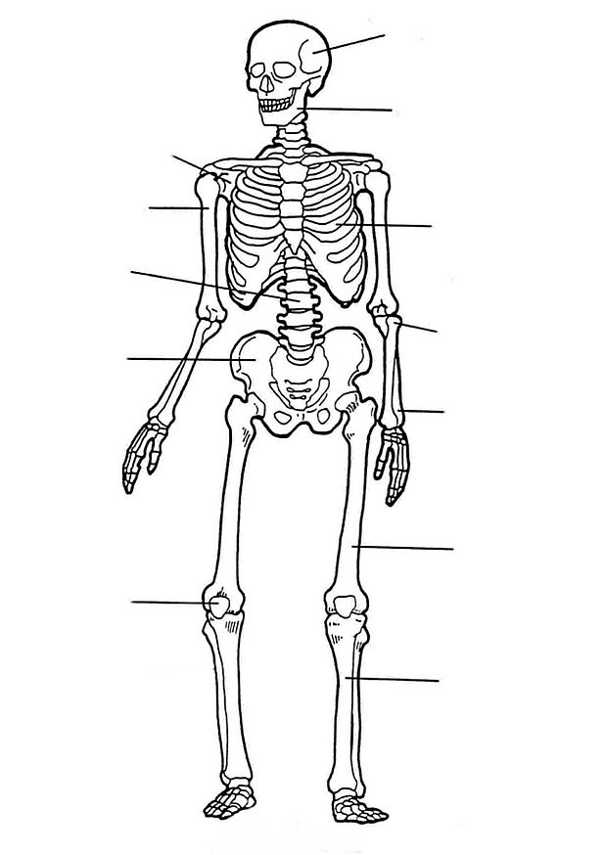
Function
- formed body
-Protect& Support vital organs
-Formed blood cell
-Reservoir of Ca , P , other ions
-Body movement (muscle)

Slide 4
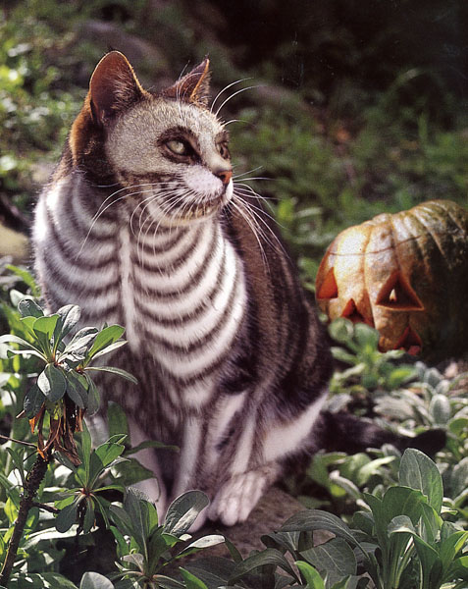

Slide 5
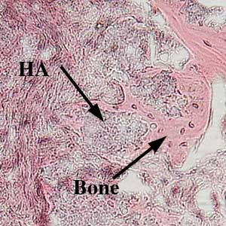
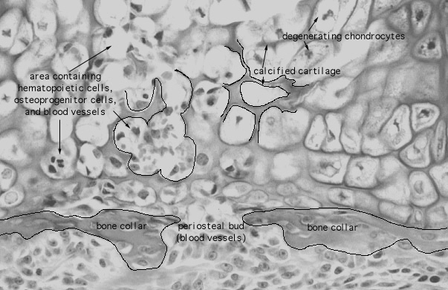
Structure
Specialized connective tissue
Cell
Fiber
Ground Substance
matrix
-Organic substance
-in -Organic substance

Slide 6
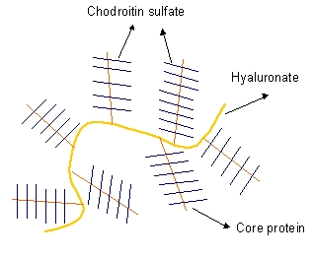
Matrix
*Organic (50%)
1- Fiber : Collagen Type I
2- Ground substance :
-Glycoprotein : Osteocalcine, osteonectin
silaloprotein
-Proteoglycan
Hydration shell : Hydrate

Slide 7
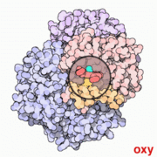
* Inorganic (50%)
Ions: Ca , p , Mg , K , Na , Hco3 , Citrate
1- Nonecrystalline
(Amorphous calcium phosphate )

Slide 8
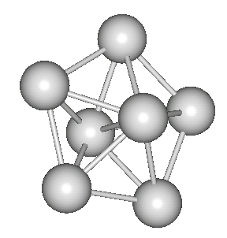
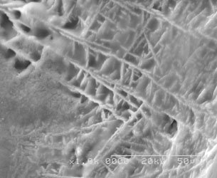
2- Crystalline
Ca (10) (Po4)6(OH2) =Hydroxy apatite crystal

Slide 9
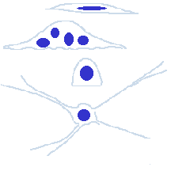
Cell
Osteoprogenitor cell
Osteoblast
Osteocyte
Osteocalst

Slide 10
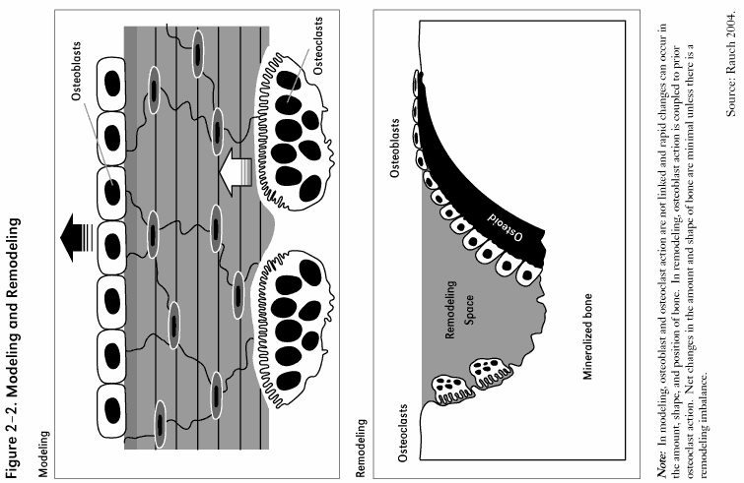
Osteoblast
Simple epithelium (cuboidal or columnar)

Slide 11
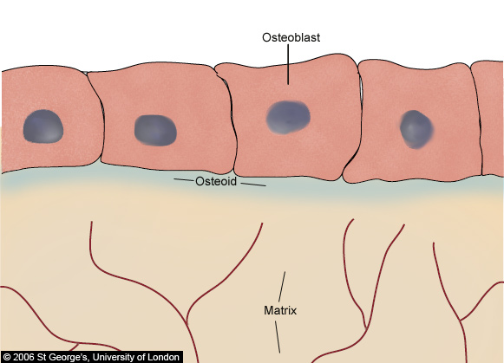
osteoid

Slide 12
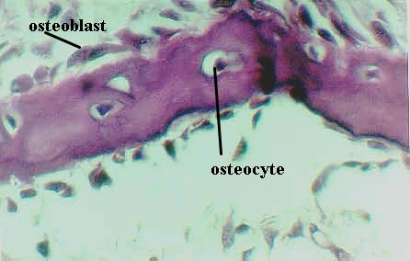
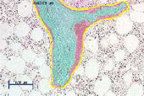
Matrix
1- organic: Osteoid
2- calcified: Osteoid + Mineral

Slide 13
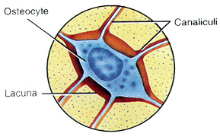
Osteocyte

Slide 14
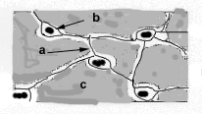
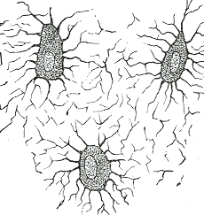
gap junction

Slide 15
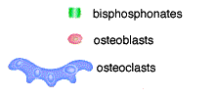
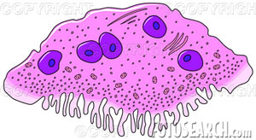
Osteoclast
absoptive zone: ruffled border , clear zone
Number of nucleus : 5-50
Cytoplasm : acidophile

Slide 16
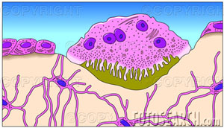
Location : Howship's lacunac
Function : Bone resorption (Enzymes)

