Slide 1
بسم الله الرحمن الرحيم

Slide 2
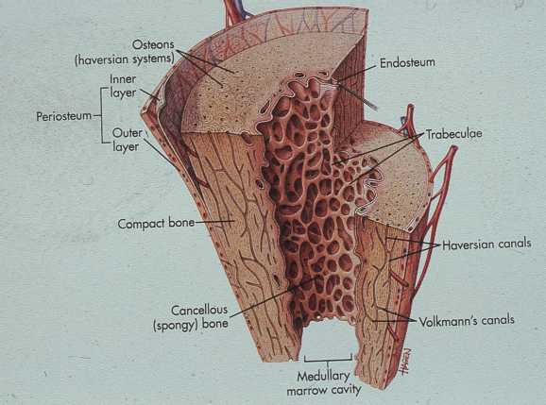

Capsules of bone
Periostrium: around of bone
Endostrium: around of bone marrow

Slide 3
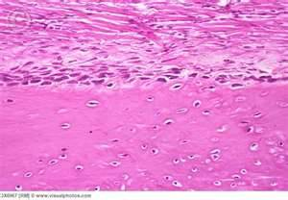
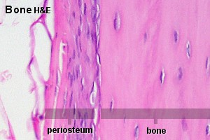
Periostrium : 2 Layers
1- Outer: Firbous connective tissue (Shapey's fiber)
2- Inner: Mesenchymal cell (osteoprogenitor cell )

Slide 4
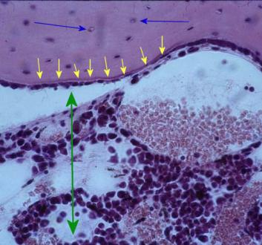
        Endostrium :
Fibrous connective tissue + mesenchymal cell

Slide 5
Type of bone
Primary bone
Secondary bone

Slide 6
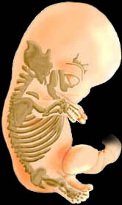
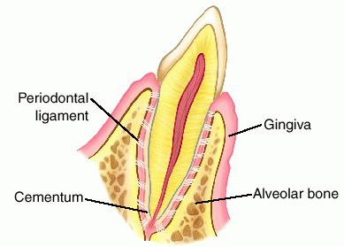
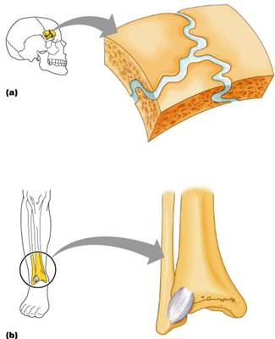
Primary bone = Immature =woven
- Embryo : all skeleton
-Adult :
-suture of skull
-insertion of tendon
-alveolar bone

Slide 7
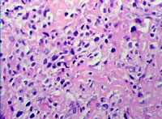
Structure
Collagen I : Irregular woven
OsteoBLAST : (Numerous & Large)
Mineral: a Few

Slide 8
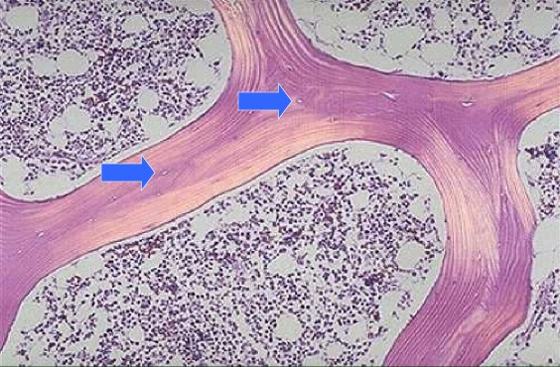
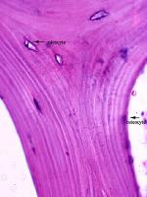
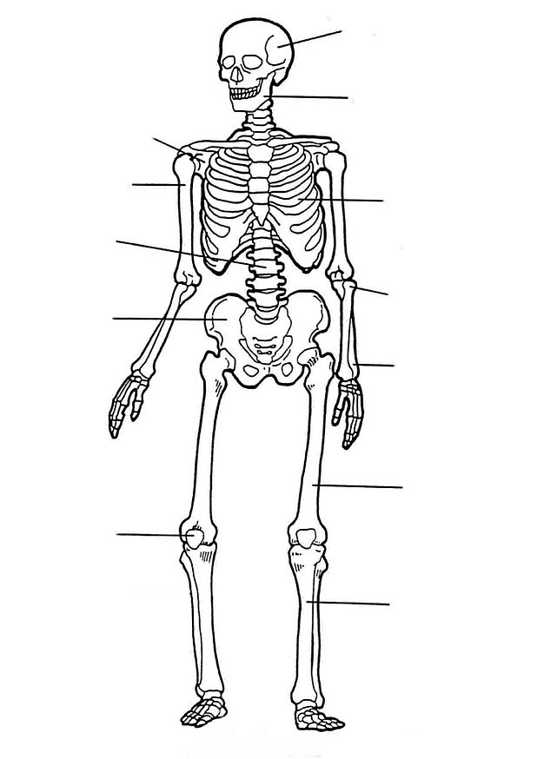
Secondary = mature
= lamellar bone
Structure : collagen I ( Regular) Lammellar
Osteocyte: small , few
Mineral : Large amount

Slide 9
Type of Secondary bone
1- Spongy bone
2- Compact bone

Slide 10
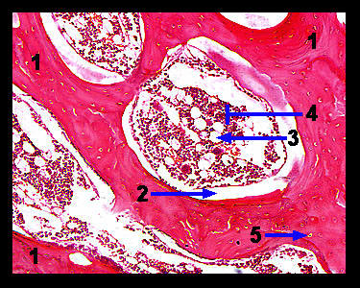
Spongy bone
flat bone

Slide 11
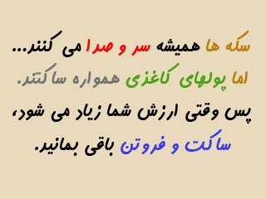

Slide 12
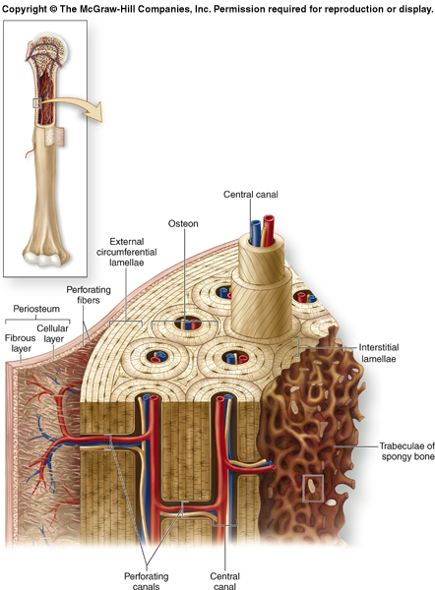
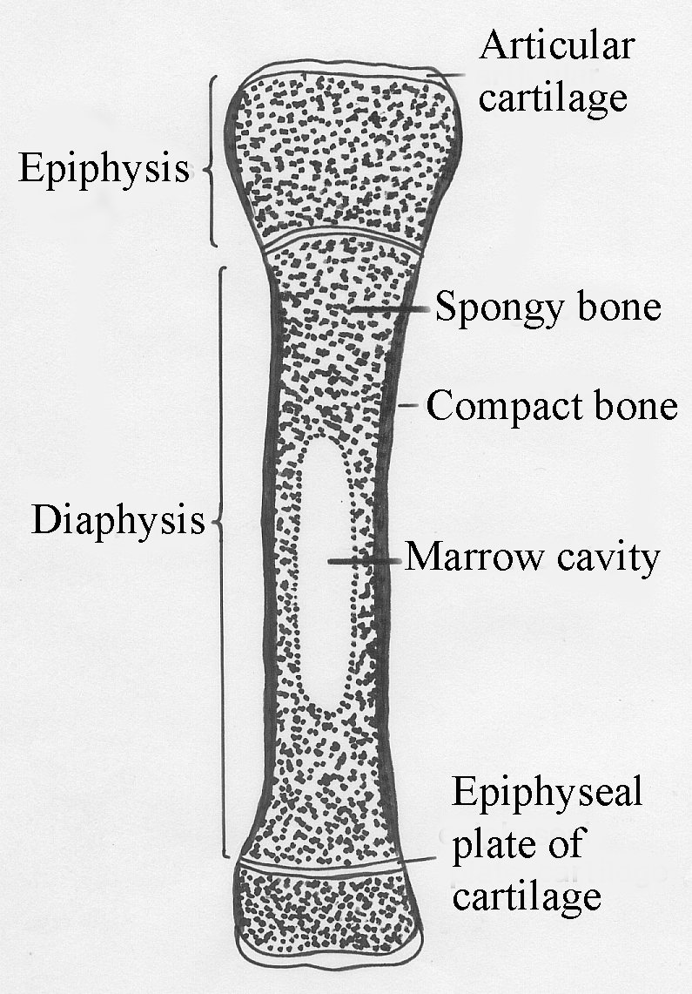
Compact bone long bone

Slide 13
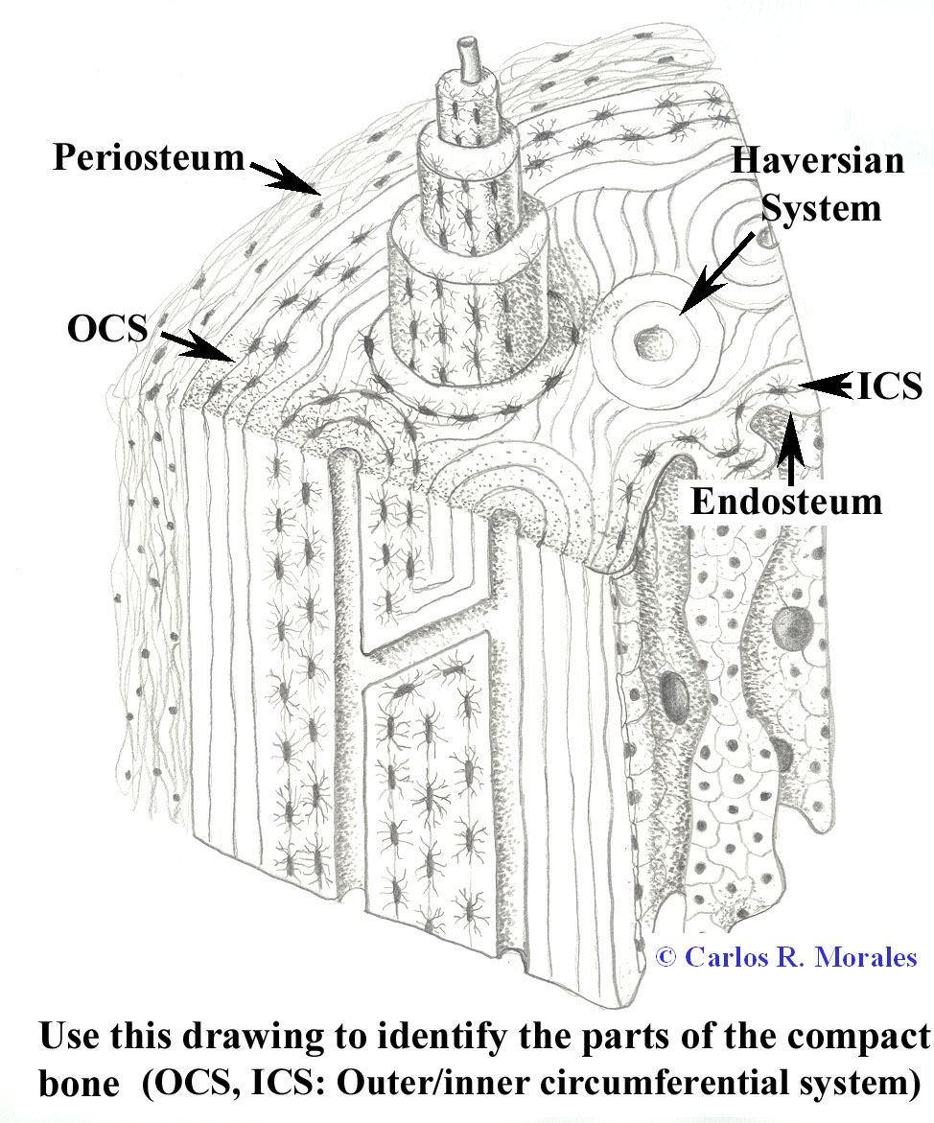

Compact bone
1- Outercircum ferential system
2- Inner circumferential system
3- Haversian system
4- Interstitial system

Slide 14
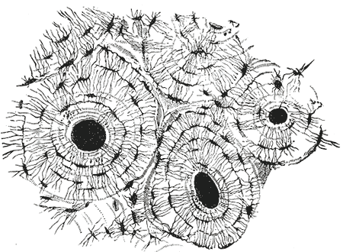
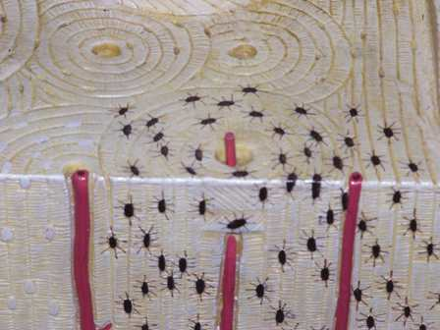
HAVERSIAN SYSTem
1-Centeral canal:
2- Concentric lamella (4-20)
(Isotropic layer & Anisotropic layer)

Slide 15
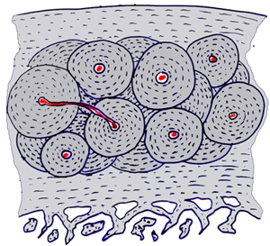
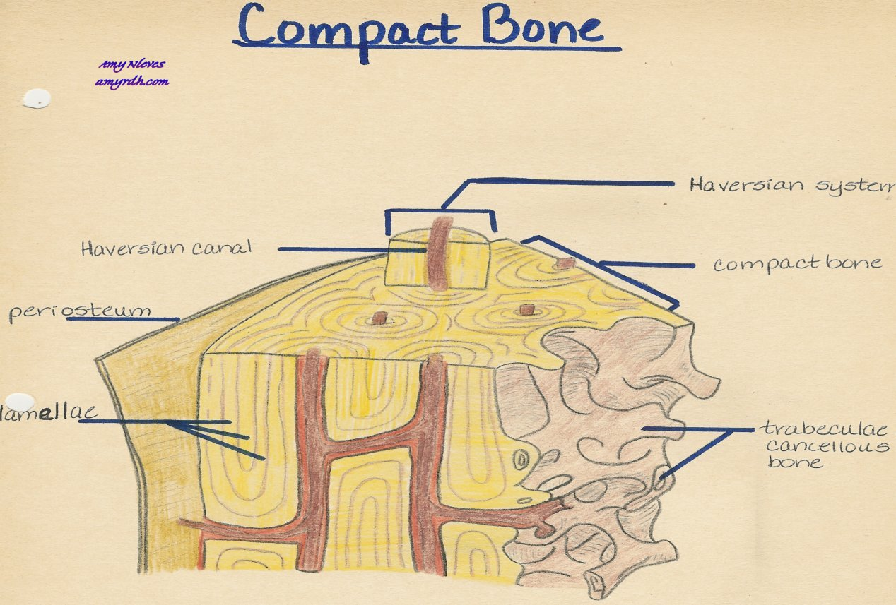
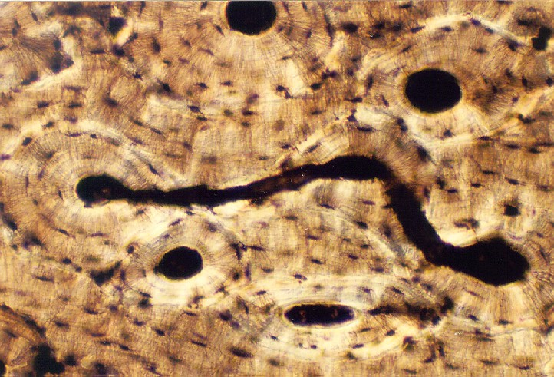
Perforating canal
VOLKMAN CANAL

Slide 16
Interstitial system

Slide 17
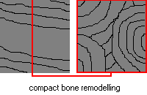

Slide 19
