Slide 1



Slide 2
Hemoglobin and hemoglobinopathies
Department of Clinical Biochemistry
Shiraz University of Medical Sciences

Slide 3
Outlines
The structure of myoglobin and hemoglobin.
The binding curves for the oxygenation of myoglobin and hemoglobin.
The structural and conformational changes in hemoglobin
The role of hemoglobin in CO2 and proton transport
Hemoglobinopathies
Sickle cell anemia
Thalassemia (Alpha thalassemia and Beta thalassemia)

Slide 4
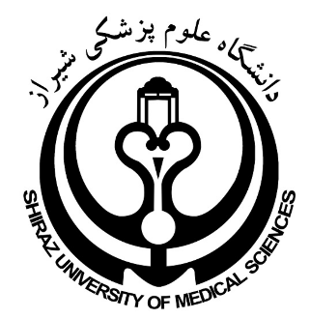
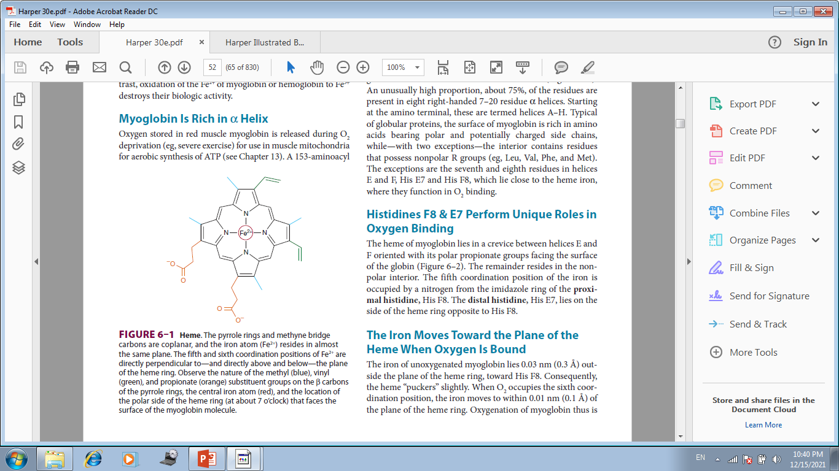

Slide 5
BIOMEDICAL IMPORTANCE
The efficient delivery of oxygen from the lungs to the peripheral tissues and the maintenance of tissue reserves to protect against anoxic episodes
Myoglobin, a monomeric protein of red muscle, binds oxygen tightly as a reserve against oxygen deprivation.
Hemoglobin, a tetrameric protein of erythrocytes, interact in a cooperative fashion that enables this transporter to offload a high proportion of bound O2 in peripheral tissues while simultaneously retaining the capacity to bind it efficiently in the lungs.
Scavenges the waste products of respiration, CO2 and protons, for transport to and ultimate disposal in the lungs.

Slide 6
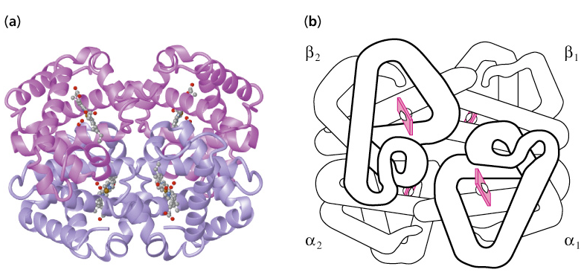
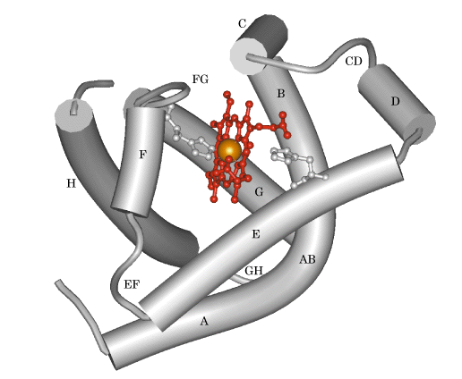
Hemoglobin
Myoglobin

Slide 7
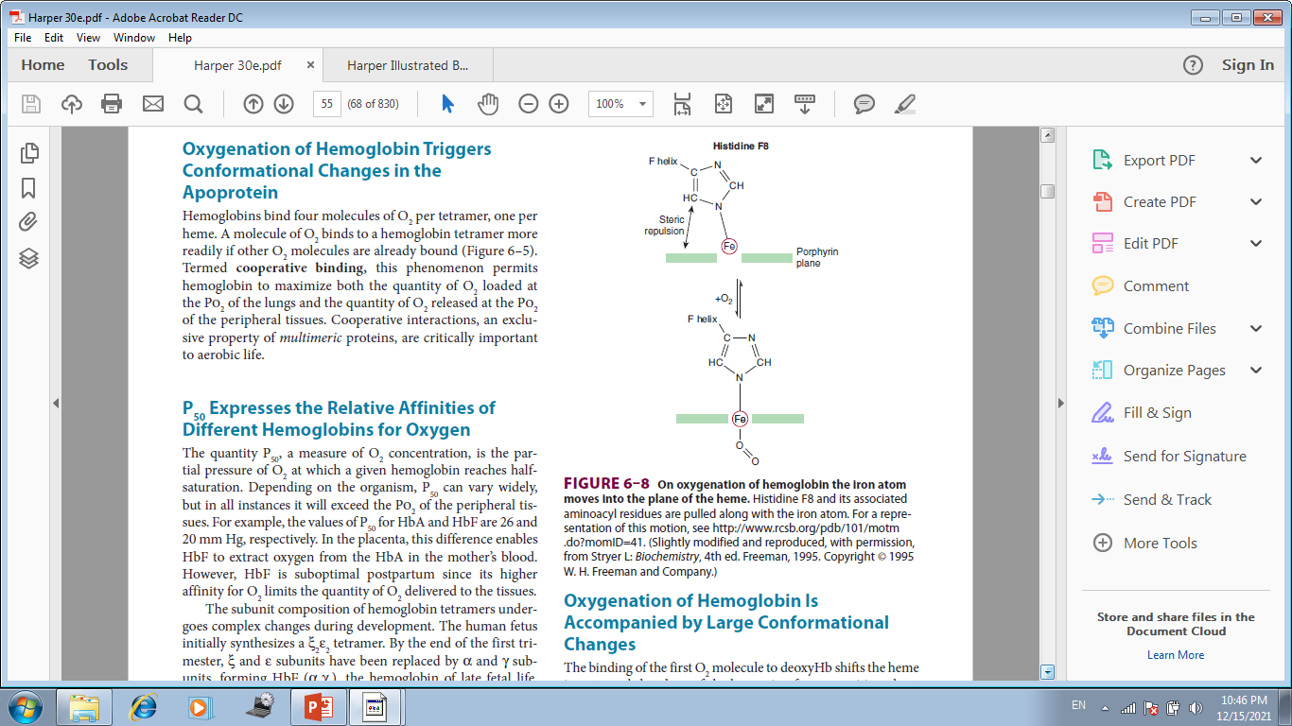

Slide 8
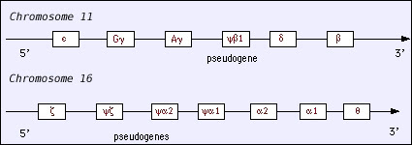
Hemoglobin's Genes

Slide 9
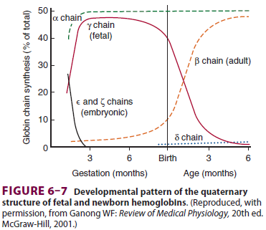

Slide 10
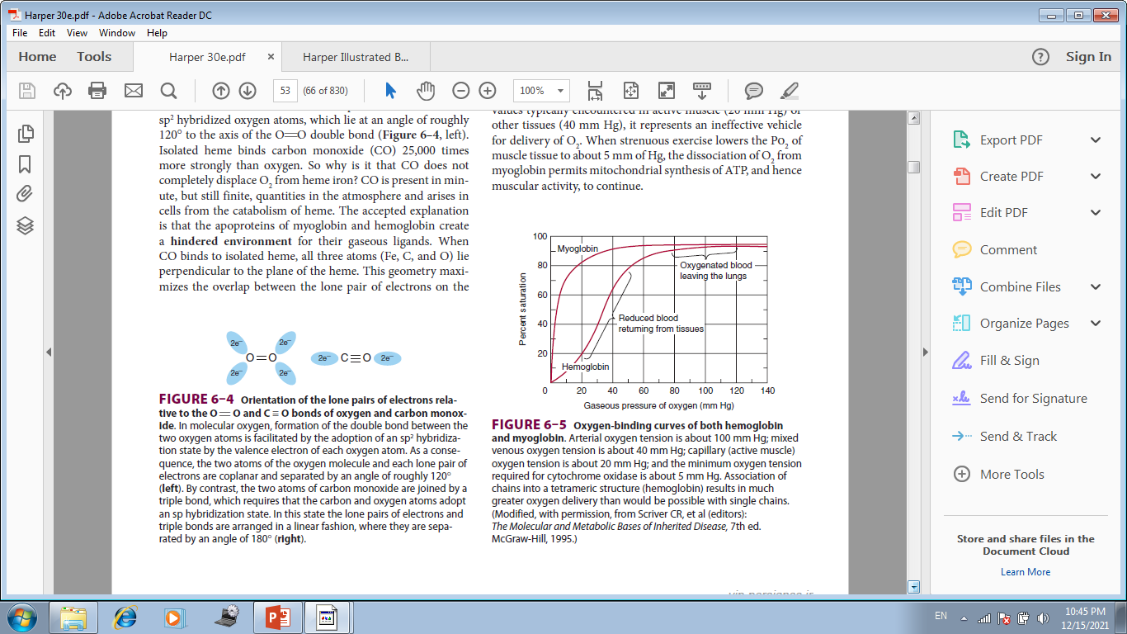

Slide 11
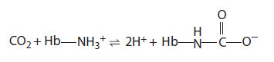
After Releasing O₂ at the Tissues, Hemoglobin Transports CO₂ & Protons to the Lungs
In addition to transporting O₂ from the lungs to peripheral tissues, hemoglobin transports CO₂, the byproduct of respiration, and protons from peripheral tissues to the lungs. Hemoglobin carries CO₂ as carbamates formed with the amino terminal nitrogens of the polypeptide chains:
Carbamate formation changes the charge on amino terminals
from positive to negative, favoring salt bridge formation between
α and β chains.

Slide 12
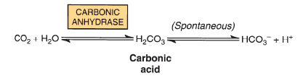
After Releasing O₂ at the Tissues, Hemoglobin Transports CO₂ & Protons to the Lungs (Cont.)
Hemoglobin carbamates account for about 15% of the CO₂ in venous blood. Much of the remaining CO₂ is carried as bicarbonate, which is formed in erythrocytes by the hydration of CO₂ to carbonic acid (H₂CO₃), a process catalyzed by carbonic anhydrase. At the pH of venous blood, H₂CO₃ dissociates into bicarbonate and a proton.

Slide 13
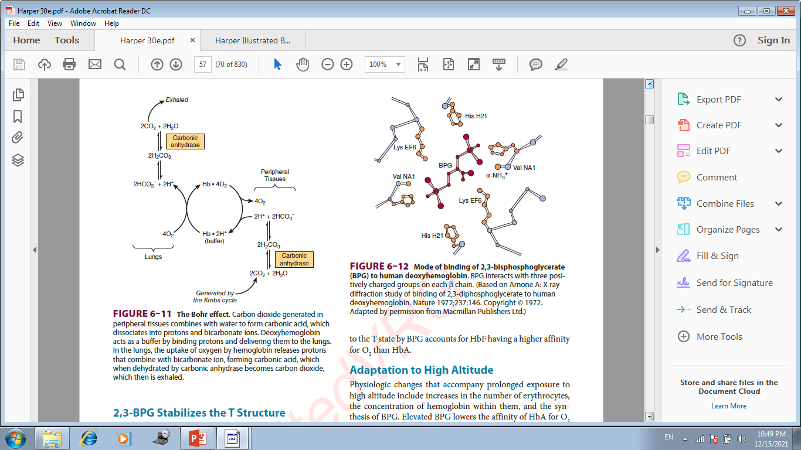

Slide 14
2,3-BPG Stabilizes the
T Structure of Hemoglobin
A low PO2 in peripheral tissues promotes the synthesis of 2,3-bisphosphoglycerate (BPG) in erythrocytes. The hemoglobin tetramer binds one molecule of BPG in the central cavity formed by its four subunits. BPG therefore stabilizes deoxygenated (T-state) hemoglobin by forming additional salt bridges that must be broken prior to conversion to the R state.

Slide 15
NUMEROUS MUTATIONS AFFECTING HUMAN
HEMOGLOBINS HAVE BEEN IDENTIFIED
Mutations in the genes that encode the α or b subunits of hemoglobin potentially can affect its biologic function. However, almost all of the over 1100 known genetic mutations affecting human hemoglobins are both extremely rare and benign, presenting no clinical abnormalities. When a mutation does compromise biologic function, the condition is termed a hemoglobinopathy.

Slide 16
Glycated Hemoglobin (HbA1c)
When blood glucose enters the erythrocytes, it glycates the ε-amino group of lysyl residues and the amino terminals of hemoglobin. The fraction of hemoglobin glycated, normally about 5%, proportionate to blood glucose concentration.
Since the half-life of an erythrocyte is typically 60 days, the level of glycated hemoglobin (HbA1c) reflects the mean blood glucose concentration over the preceding 6 to 8 weeks. Measurement of HbA1c therefore provides valuable information for management of diabetes mellitus.

Slide 17
Hemoglobin S
In HbS, the nonpolar amino acid valine has replaced the polar surface residue Glu6 of the b subunit, generating a hydrophobic “sticky patch” on the surface of the b subunit of both oxyHbS and deoxyHbS. Both HbA and HbS contain a complementary sticky patch on their surfaces that is exposed only in the deoxygenated T state. Thus, at low PO2, deoxy- HbS can polymerize to form long, insoluble fibers.

Slide 18
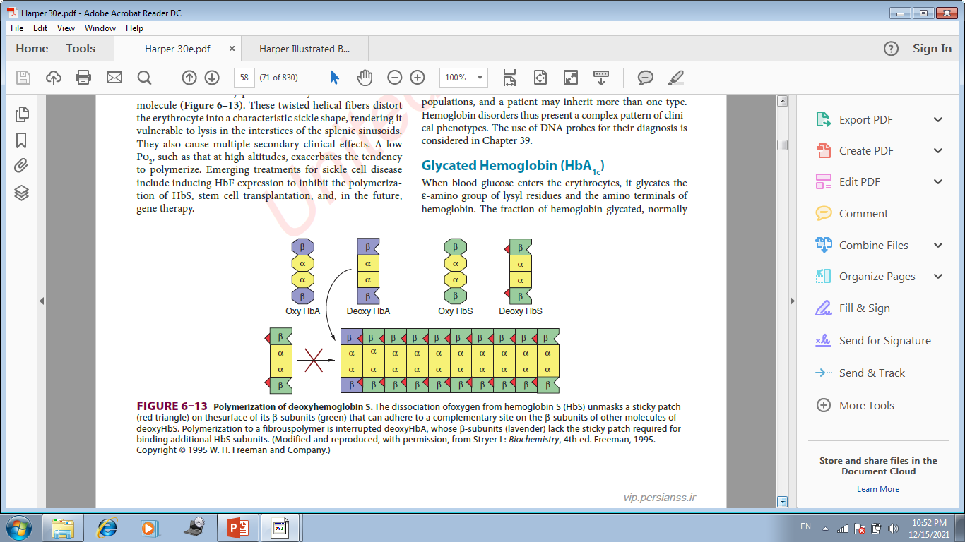

Slide 19
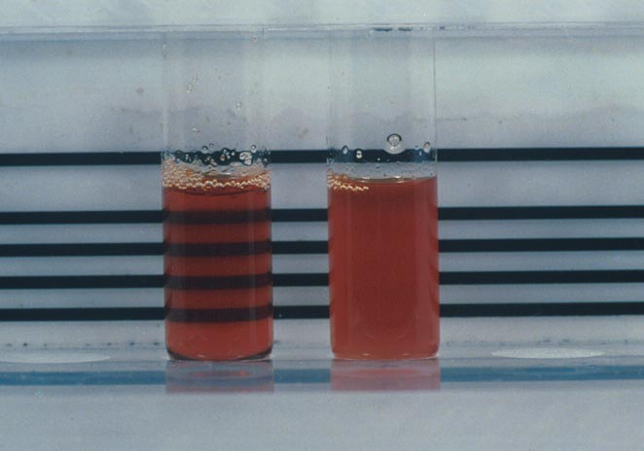
Laboratory Methods to evaluate
Hemoglobin
Solubility test (Sickledex):
  Test to identify HbS. HbS is relatively insoluble compared to other Hemoglobins.
  Add reducing agent
  HbS will precipitate forming and opaque solution compared with the clear pink solution seen in HbS is not present.

Slide 20
Thalassemias
The genetic defects known as thalassemias result from the partial or total absence of one or more α or b chains of hemoglobin. Over 750 different mutations have been identified, but only three are common. Either the α chain (alpha thalassemias) or b chain (beta thalassemias) can be affected. A superscript indicates whether a subunit is completely absent (α⁰ or b⁰) or whether its synthesis is reduced (α⁻ or b⁻). Apart from marrow transplantation, treatment is symptomatic.
Certain mutant hemoglobins are common in many populations, and a patient may inherit more than one type.

Slide 21
Thalassemias (Cont.)
Thalassemias are a heterogenous group of genetic disorders
  Individuals with homozygous forms are severely affected and die early in childhood without treatment
  Heterozygous individuals exhibit varying levels of severity
  The disorders are due to mutations that decrease the rate of synthesis of one of the two globin chains (α or β). The genetic defect may be the result of:

Slide 22
Classifications of Anemias
Microcytic, Hypochromic
  Iron deficiency
  Sideroblastic
  Chronic disease, Inflammation
  Lead poisoning
  Thalassemia trait

Slide 23
Classification & Terminology
Alpha Thalassemia
  Normal αα/αα
  Silent carrier - α/αα
  Minor -α/-α
  --/αα
  Hb H disease --/-α
  Barts hydrops fetalis --/--

Slide 24
α Thalassemia
Predominant cause of alpha thalassemias is large number of gene deletions in the α-globin genes.
There are four clinical syndromes present in alpha thalassemia:
  Silent Carrier State
  Alpha Thalassemia Trait (Alpha Thalassemia Minor)
  Hemoglobin H Disease
  Bart's Hydrops Fetalis Syndrome

Slide 25
Silent Carrier α Thalassemia
-α/αα
One alpha gene deletion, 3 intact alpha genes.
Healthy persons.
Normal Hb and Hct
No treatment
Can only be detected by DNA studies.

Slide 26
Hemoglobin H Disease
Second most severe form alpha thalassemia.
Usually caused by presence of only one intact α gene producing alpha chains (--/-α).
Results in accumulation of excess unpaired gamma or beta chains.
Born with 10-40% Bart's hemoglobin (g4). Gradually replaced with Hemoglobin H (β4). In adult, have about 5-40% HbH.
γ4 β4

Slide 27
Bart’s Hydrops Fetalis Syndrome
Most severe form. Incompatible with life. Have no functioning α chain genes (- -/- -).
Baby born with hydrops fetalis, which is edema and ascites caused by accumulation serous fluid in fetal tissues as result of severe anemia. Also we will see hepatosplenomegaly and cardiomegaly.
Predominant Hb is Hb Bart, along with Hb Portland and traces of HbH.
Hb Bart's has high oxygen affinity so cannot carry oxygen to tissues. Fetus dies in utero or shortly after birth. At birth, you will see severe hypochromic, microcytic anemia with numerous NRBCs.

Slide 28
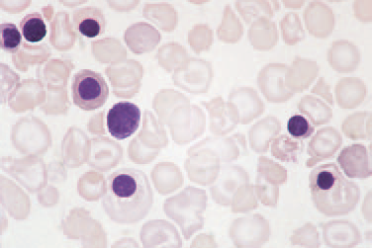
Hydrops Fetalis
The blood film of neonate with hemoglobin Bart’s hydrops fetalis showing anisocytosis, poikilocytosis and numerous nucleated red blood cells (NRBC).

Slide 29
β Thalassemia
They are the most important types of thalassemias because they are so common and usually produce severe anemia in their homozygous and compound heterozygous states (compound= when combined with other hemoglobinopathies or thalassemias).
β thalassemias are autosomal inherited disorders of b globin synthesis. In most, globin structure is normal but the rate of production is reduced because of decrease in transcription of DNA, abnormal processing of pre-mRNA, or decreased translation of mRNA leading to decreased Hb-A production (A=Adult).

Slide 30
β Thalassemia Major
ß⁰-thal
Characterized by very severe microcytic, hypochromic anemia.
Detected early in childhood:
Hb level lies between 2 and 8 g/dL.
Severe anemia causes marked bone changes due to expansion of marrow space for increased erythropoiesis (Epo is increased).
See characteristic changes in skull, long bones, and hand bones.

Slide 31
β Thalassemia Major (Cooley’s Anemia)
Have protrusion upper teeth and Mongoloid facial features.
Physical growth and development delayed.
Peripheral blood shows markedly hypochromic, microcytic erythrocytes with extreme poikilocytosis, such as target cells and elliptocytes.
Retic count seen (2-8%).
Most of Hemoglobin present is Hb F with slight increase in HbA₂.

Slide 32
β Thalassemia Major
Regular transfusions usually begin around one year of age and continue throughout life.
Excessive number of transfusions results in tranfusional hemosiderosis; Without iron chelation, patient develops cardiac disease, liver cirrhosis, and endocrine deficiencies.
Dangers in continuous tranfusion therapy:
  Development of iron overload.
  Development of alloimmunization (developing antibodies to transfused RBCs).
  Risk of transfusion-transmitted diseases (e.g. hepatitis, AIDS).
Bone marrow transplants may be future treatment, along with genetic engineering and new drug therapies.

Slide 33
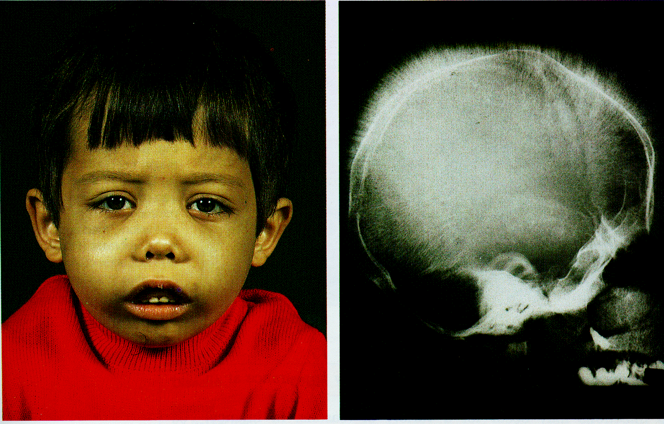
β Thalassemia Major (Cooley’s Anemia)

Slide 34
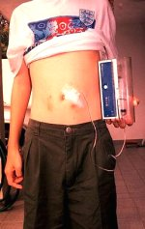
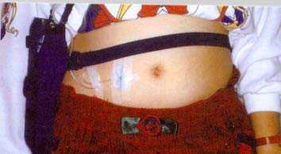
Good iron chelation using desferoxamine (iron chelator) prolongs the life expectancy of Cooley’s anemic patients, otherwise cardiac failure, liver cirrhosis, and endocrine deficiencies could occur and causing death.
Thalassemics:Blood Transfusion and Iron chelating

Slide 35

The End

